Slide 1





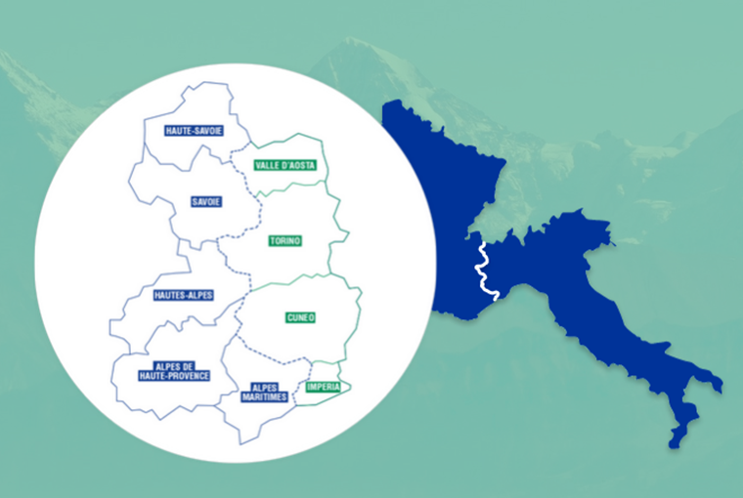



Quels effets de l’environnement et des stratégies de lutte sur les charges virales?
Relation Abeilles/Varroa/Virus
Pelleautier : 11 janvier/gennaio 2024
Restitution finale / Incontro divulgativo finale

Slide 2
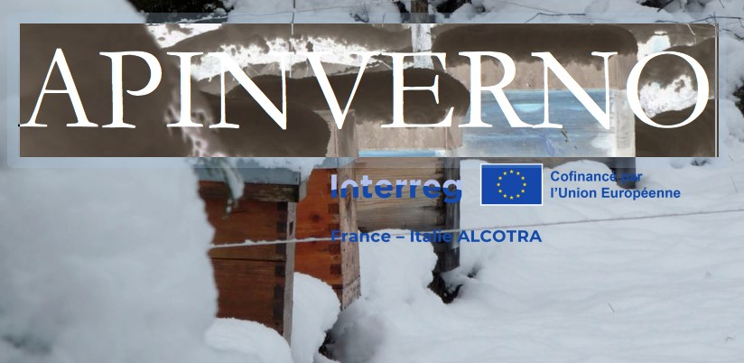

Diagnostic et quantification des virus de l'abeille
Cristina Marzachì^{1*}, Valeria Grande^{1,2}, Simone Tosi³
¹ IPSP-CNR, Torino (I)
² Università del Piemonte Orientale, Alessandria (I)
³ Università di Torino (I)
* Presenting author
Notes:
Despite the defenses, Varroa has dramatic impacts on colonies in most cases.
These are attributed to the direct impact of V on individuals, but also, and maybe primarily to the association of the mite with several viruses.
…
Therefore, we can wonder what actually causes the pathogenic effects that are observed in the presnece of V.
…
The leads us to revise the conception of H/P relationship from a bilateral situation, to a 3 way relationship that included virus as a main actor.

Slide 3
Plan de la présentation
Introduction
Virus des abeilles
Les méthodes
Les échantillonnages
Collecte et conservation des échantillons, extraction de l'ARN total et diagnostic/quantification des cinq virus
Analyse des résultats
Résultats
Conclusions
Notes:
Despite the defenses, Varroa has dramatic impacts on colonies in most cases.
These are attributed to the direct impact of V on individuals, but also, and maybe primarily to the association of the mite with several viruses.
…
Therefore, we can wonder what actually causes the pathogenic effects that are observed in the presnece of V.
…
The leads us to revise the conception of H/P relationship from a bilateral situation, to a 3 way relationship that included virus as a main actor.

Slide 4
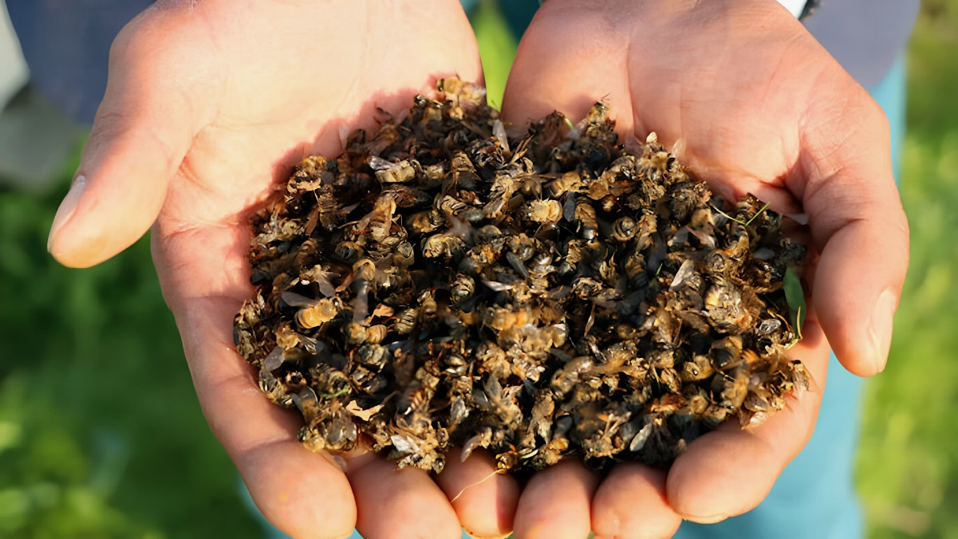
Introduction
Les abeilles mellifères sont confrontées à de nombreuses menaces de maladies (virus, parasites, bactéries et champignons)
Varroa destructor et virus

Slide 5
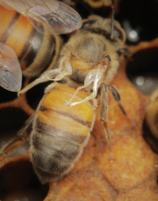
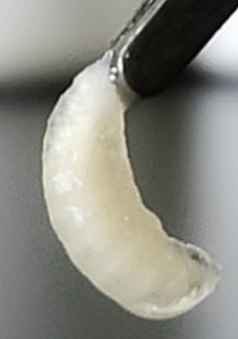

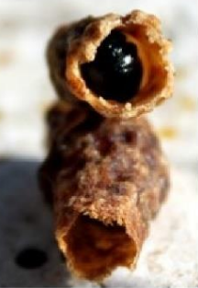
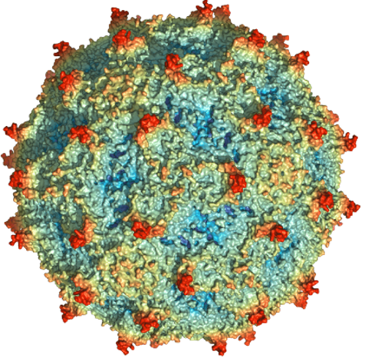
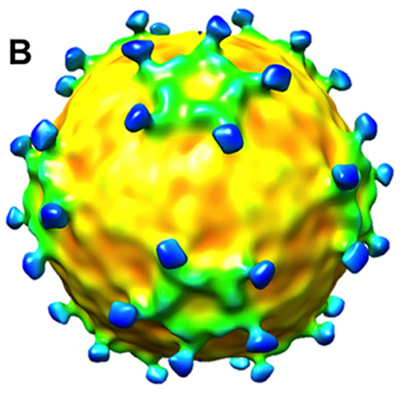
Introduction
Virus des abeilles
Picornavirales (+) ssRNA
Dicistroviridae
Iflaviridae
?
ABPV-IAPV-KBV
Acute bee paralysis virus complex
BQCV
Black queen cell virus
DWV-A DWV-B
Deformed wing virus complex
Virus des ailes déformées
SBV
Sacbrood virus
CBPV
Chronic bee paralysis virus
Notes:
Despite the defenses, Varroa has dramatic impacts on colonies in most cases.
These are attributed to the direct impact of V on individuals, but also, and maybe primarily to the association of the mite with several viruses.
…
Therefore, we can wonder what actually causes the pathogenic effects that are observed in the presnece of V.
…
The leads us to revise the conception of H/P relationship from a bilateral situation, to a 3 way relationship that included virus as a main actor.

Slide 6
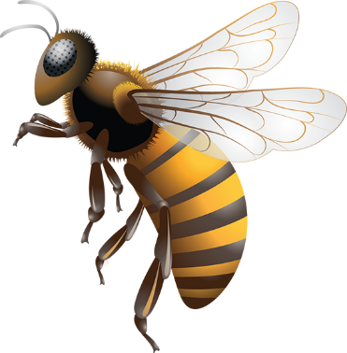




Introduction
Virus des abeilles
Certains de ces virus sont transmis par Varroa
Transmission Virus | V. destructor | Oral | Contact | Verticale (à la descendance)
ABPV | + | + | - | +
BQCV | ? | + | + | +
DWV | + | + | + | +
CBPV | - | + | + | ?
SBV | + | + | + | +
Notes:
Despite the defenses, Varroa has dramatic impacts on colonies in most cases.
These are attributed to the direct impact of V on individuals, but also, and maybe primarily to the association of the mite with several viruses.
…
Therefore, we can wonder what actually causes the pathogenic effects that are observed in the presnece of V.
…
The leads us to revise the conception of H/P relationship from a bilateral situation, to a 3 way relationship that included virus as a main actor.

Slide 7
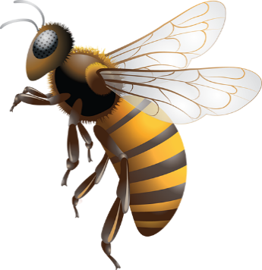


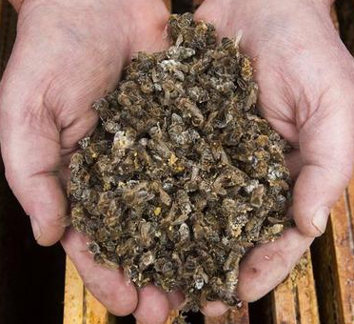
Introduction
Virus des abeilles
A. mellifera / V. destructor / virus
L'infection par un ou plusieurs virus peut aggraver la santé de la colonie, déjà compromise par le parasitisme de Varroa.
Notes:
Despite the defenses, Varroa has dramatic impacts on colonies in most cases.
These are attributed to the direct impact of V on individuals, but also, and maybe primarily to the association of the mite with several viruses.
…
Therefore, we can wonder what actually causes the pathogenic effects that are observed in the presnece of V.
…
The leads us to revise the conception of H/P relationship from a bilateral situation, to a 3 way relationship that included virus as a main actor.

Slide 8
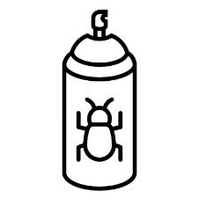


Introduction
Virus des abeilles
A. mellifera / V. destructor / virus
Éliminer les acariens.
Réduire la transmission du virus par les acariens.
Améliorer la santé des abeilles.
Notes:
Despite the defenses, Varroa has dramatic impacts on colonies in most cases.
These are attributed to the direct impact of V on individuals, but also, and maybe primarily to the association of the mite with several viruses.
…
Therefore, we can wonder what actually causes the pathogenic effects that are observed in the presnece of V.
…
The leads us to revise the conception of H/P relationship from a bilateral situation, to a 3 way relationship that included virus as a main actor.

Slide 9






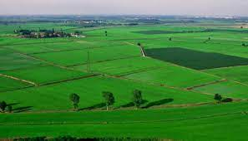
Introduction
Quelques détails pour décrire les résultats présentés aujourd'hui
Quatre échantillonages: 452 échantillons
Deux échantillonages: 214 échantillons
10/21 | 04/22 | 07/22 | 09/22
119 | 105 | 108 | 120
10/21 | 03/22 | 06/22
120 | - | 94
Deux conditions d’hivernage: montagne et plaine
Deux traitements : encagées/non encagées
Notes:
Despite the defenses, Varroa has dramatic impacts on colonies in most cases.
These are attributed to the direct impact of V on individuals, but also, and maybe primarily to the association of the mite with several viruses.
…
Therefore, we can wonder what actually causes the pathogenic effects that are observed in the presnece of V.
…
The leads us to revise the conception of H/P relationship from a bilateral situation, to a 3 way relationship that included virus as a main actor.

Slide 10
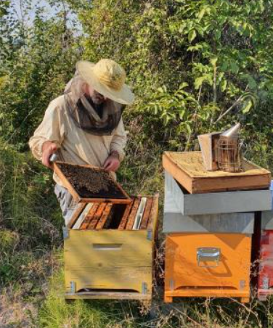
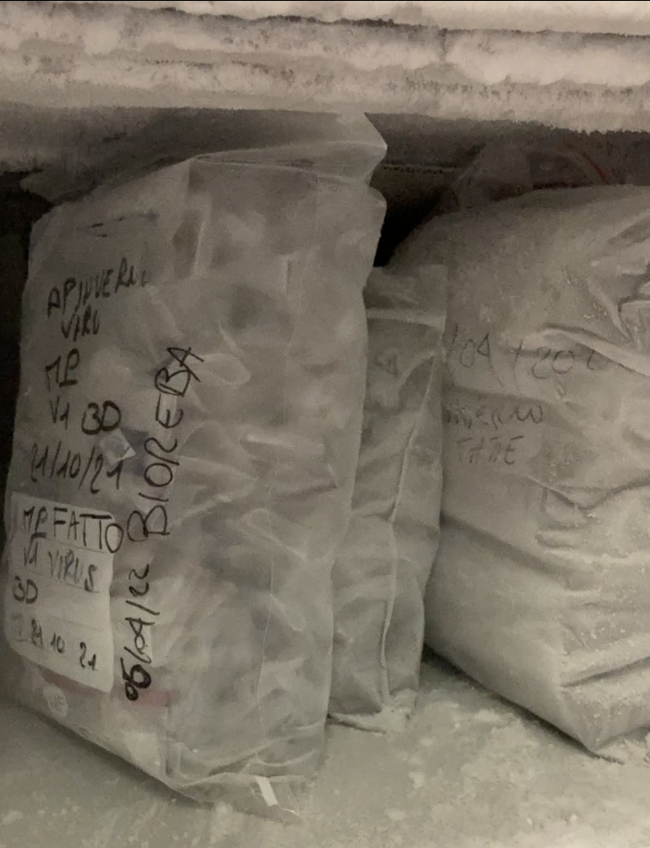
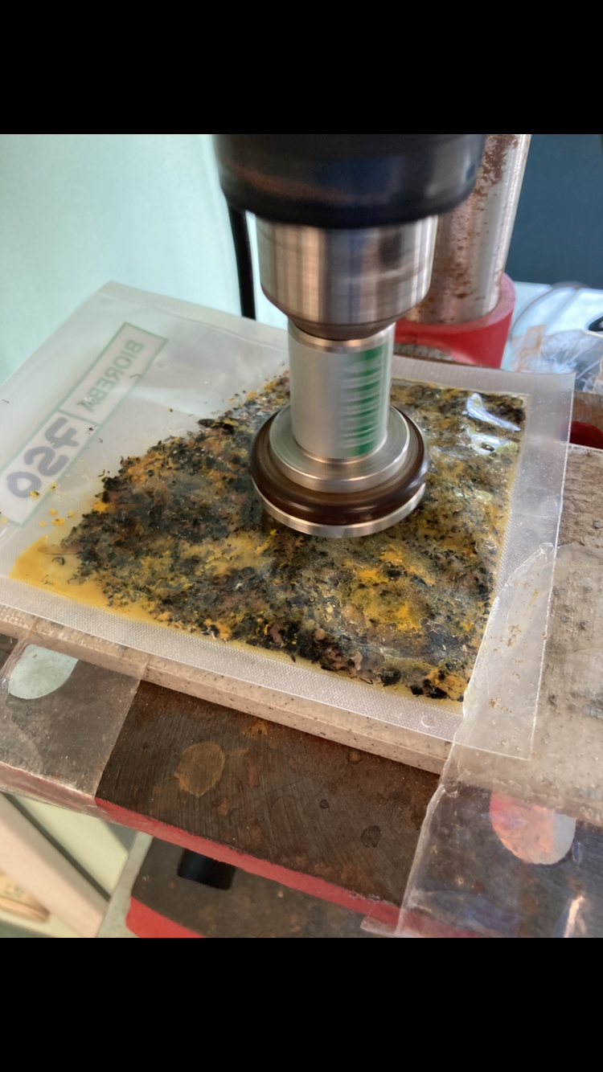
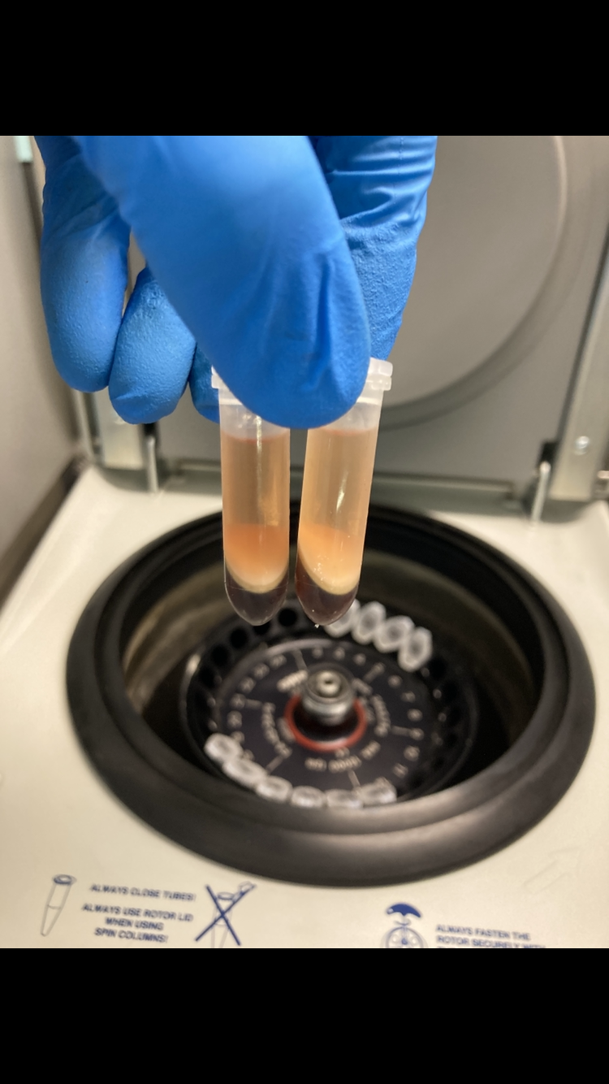
Méthodes
Les échantillonnages
Quantification:
ABPV-complex
BQCV
CBPV
DWV-complex
SBV
Synthèse de l'ADNc
RT-qPCR
Notes:
Despite the defenses, Varroa has dramatic impacts on colonies in most cases.
These are attributed to the direct impact of V on individuals, but also, and maybe primarily to the association of the mite with several viruses.
…
Therefore, we can wonder what actually causes the pathogenic effects that are observed in the presnece of V.
…
The leads us to revise the conception of H/P relationship from a bilateral situation, to a 3 way relationship that included virus as a main actor.

Slide 11
Résultats
Combien des colonies sont infectées par des virus?
Fréquence des colonies infectées par au moins un virus (%)
N=452
N=214
Plus de 95% des colonies analysées étaient infectées par au moins un virus dans les deux pays.
Notes:
Despite the defenses, Varroa has dramatic impacts on colonies in most cases.
These are attributed to the direct impact of V on individuals, but also, and maybe primarily to the association of the mite with several viruses.
…
Therefore, we can wonder what actually causes the pathogenic effects that are observed in the presnece of V.
…
The leads us to revise the conception of H/P relationship from a bilateral situation, to a 3 way relationship that included virus as a main actor.

Slide 12
Résultats
La présence d'au moins un virus est-elle différente dans les colonies ayant subi la mise en cage de la reine?
Fréquence des colonies infectées par au moins un virus (%)
N= 212
N= 240
La présence des différents virus est similaire dans les colonies qui ont subi la mise en cage de la reine et dans celles qui ne l'ont pas subi.
Notes:
Despite the defenses, Varroa has dramatic impacts on colonies in most cases.
These are attributed to the direct impact of V on individuals, but also, and maybe primarily to the association of the mite with several viruses.
…
Therefore, we can wonder what actually causes the pathogenic effects that are observed in the presnece of V.
…
The leads us to revise the conception of H/P relationship from a bilateral situation, to a 3 way relationship that included virus as a main actor.

Slide 13
Résultats
Présence de virus dans les colonies en montagne et dans celles en plaine.
Fréquence des colonies infectées par au moins un virus (%)
N= 212
N= 240
La présence des différents virus est similaire dans les colonies de montagne et de plaine.
Notes:
Despite the defenses, Varroa has dramatic impacts on colonies in most cases.
These are attributed to the direct impact of V on individuals, but also, and maybe primarily to the association of the mite with several viruses.
…
Therefore, we can wonder what actually causes the pathogenic effects that are observed in the presnece of V.
…
The leads us to revise the conception of H/P relationship from a bilateral situation, to a 3 way relationship that included virus as a main actor.

Slide 14
Résultats
Répartition des 5 virus dans les colonies analysées dans les deux pays.
Fréquence des colonies infectées par chaque virus (%)
N=452
N=214
Le BQCV et le DWV sont les virus les plus répandus dans les deux pays. Le BQCV est le plus prévalent en Italie, le DWV en France. Les trois autres virus sont moins fréquents.
Notes:
Despite the defenses, Varroa has dramatic impacts on colonies in most cases.
These are attributed to the direct impact of V on individuals, but also, and maybe primarily to the association of the mite with several viruses.
…
Therefore, we can wonder what actually causes the pathogenic effects that are observed in the presnece of V.
…
The leads us to revise the conception of H/P relationship from a bilateral situation, to a 3 way relationship that included virus as a main actor.

Slide 15
Résultats
Pour chaque virus, la prévalence varie-t-elle en fonction de la saison?
Fréquence des colonies infectées par chaque virus (%)
La prévalence de l'ABPV et du SBV est la plus faible au printemps et la plus élevée en été.
La prévalence de BQCV et de DWV est stable au printemps, et augmente en été.
La prévalence de CBPV augmente au printemps et diminue à l'automne.
Notes:
Despite the defenses, Varroa has dramatic impacts on colonies in most cases.
These are attributed to the direct impact of V on individuals, but also, and maybe primarily to the association of the mite with several viruses.
…
Therefore, we can wonder what actually causes the pathogenic effects that are observed in the presnece of V.
…
The leads us to revise the conception of H/P relationship from a bilateral situation, to a 3 way relationship that included virus as a main actor.

Slide 16
Résultats
Prévalence de chaque virus dans les colonies qui ont subi la mise en cage de la reine et dans celles qui ne l'ont pas subi.
Fréquence (%) des colonies infectées par chaque virus dans les 2 conditions (encagé et non encagé)
ABPV BQCV CBPV DWV SBV
Globalement, la mise en cage (de la reine) n'a pas réduit la fréquence des colonies infectées par les différents virus analysés.
Notes:
Despite the defenses, Varroa has dramatic impacts on colonies in most cases.
These are attributed to the direct impact of V on individuals, but also, and maybe primarily to the association of the mite with several viruses.
…
Therefore, we can wonder what actually causes the pathogenic effects that are observed in the presnece of V.
…
The leads us to revise the conception of H/P relationship from a bilateral situation, to a 3 way relationship that included virus as a main actor.

Slide 17
Conclusions
Les virus sont presque omniprésents dans les ruchers analysés dans les deux pays.
La prévalence de chaque virus, ainsi que la charge virale, varient dans le temps et de manière différente selon le virus.
Le BQCV est le virus le plus fréquent dans les colonies analysées en Italie, tandis que le DWV est le plus répandu dans les colonies françaises.
La présence des différents virus est similaire dans les colonies de montagne et de plaine et la mise en cage de la reine n'a pas réduit la fréquence des colonies infectées par les différents virus.
L'infestation de Varroa en Italie a été très faible et constante au fil du temps, et en tout cas peu affectée par les différents traitements appliqués dans le cadre du projet.
Il est très probable que les virus analysés puissent également être transmis par d'autres voies que le varroa.
La transmission de varroa n'a été démontrée que pour l'ABPV, le DWV et le SBV.
Notes:
Despite the defenses, Varroa has dramatic impacts on colonies in most cases.
These are attributed to the direct impact of V on individuals, but also, and maybe primarily to the association of the mite with several viruses.
…
Therefore, we can wonder what actually causes the pathogenic effects that are observed in the presnece of V.
…
The leads us to revise the conception of H/P relationship from a bilateral situation, to a 3 way relationship that included virus as a main actor.

Slide 18
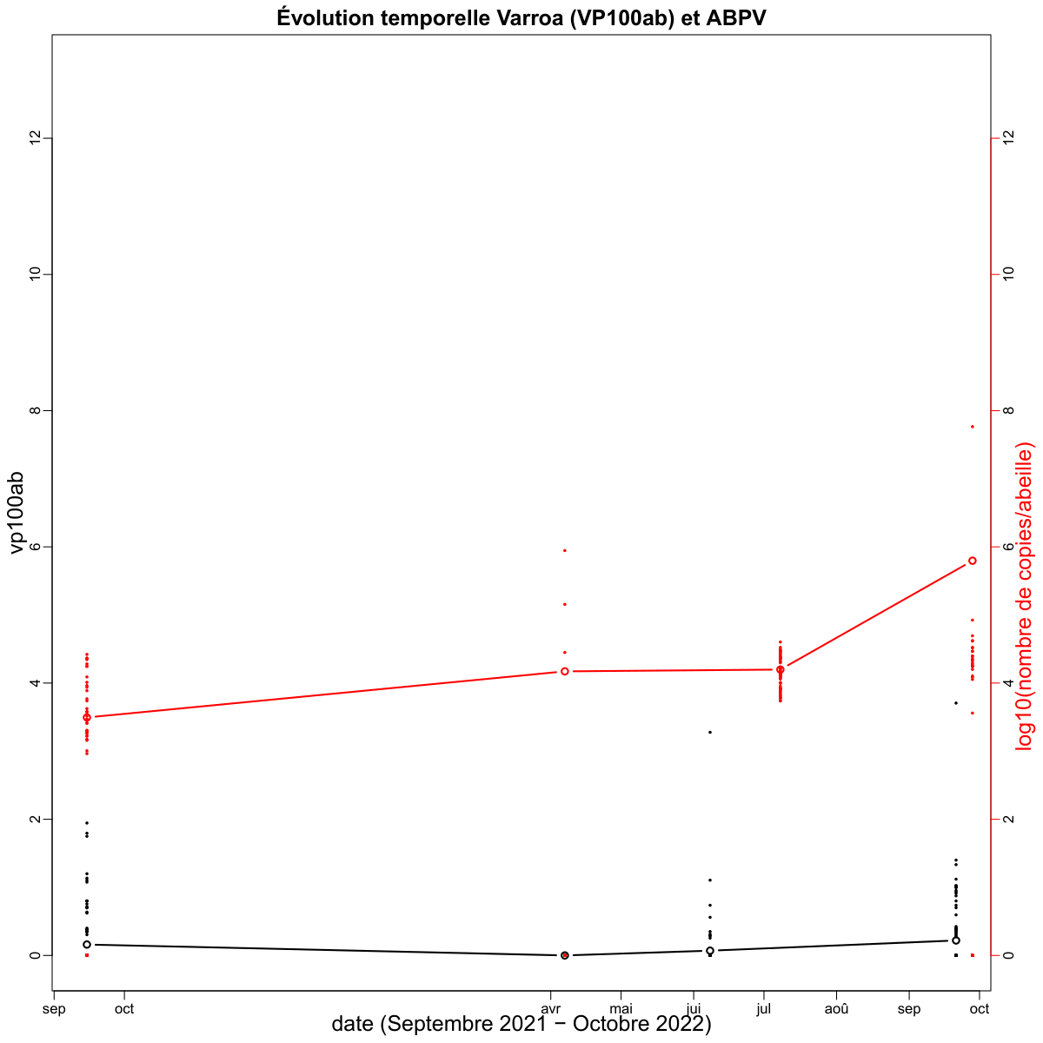
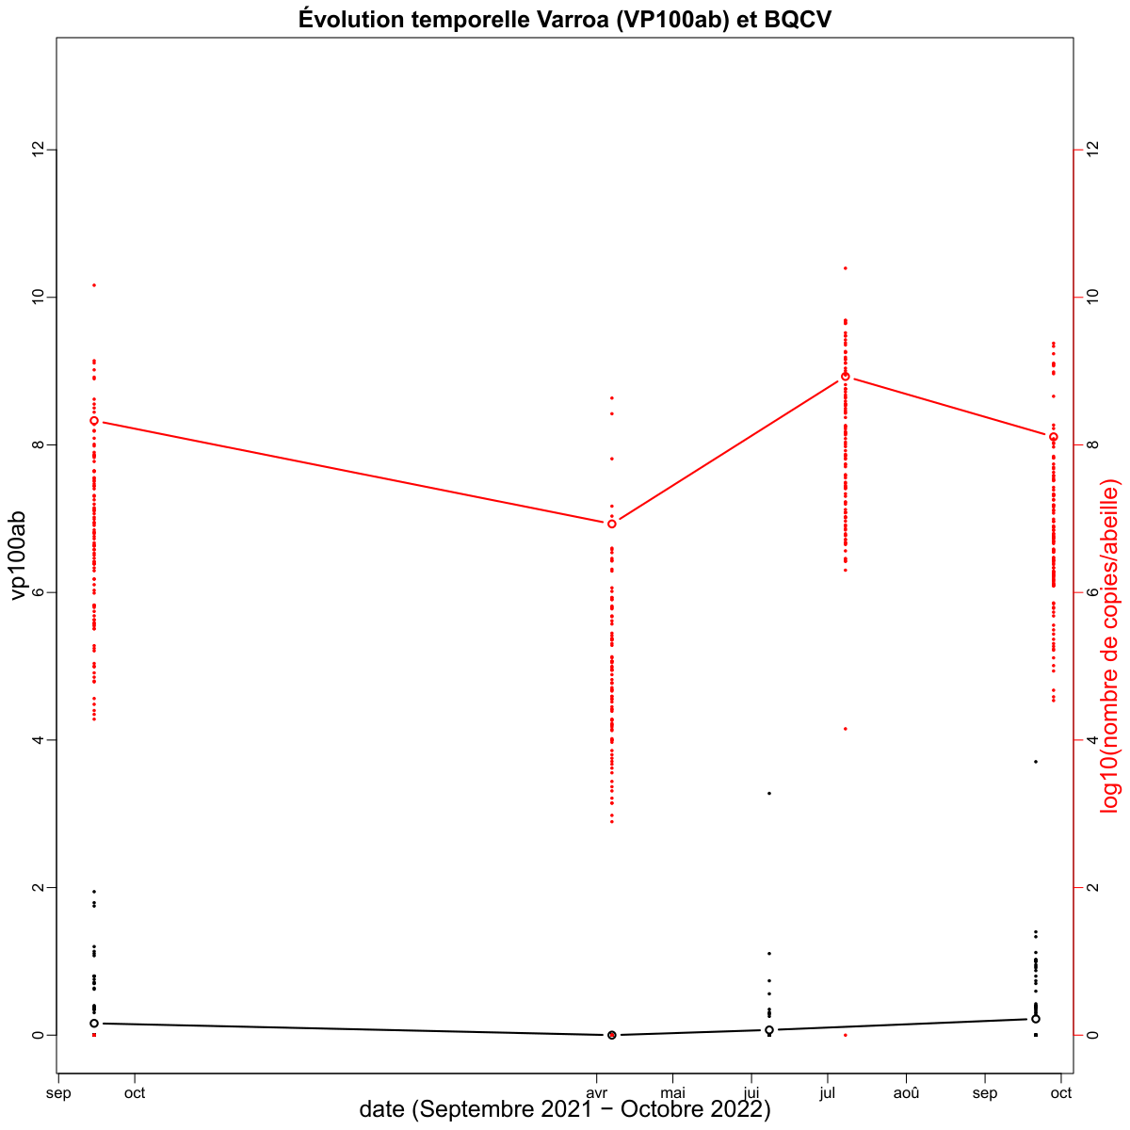
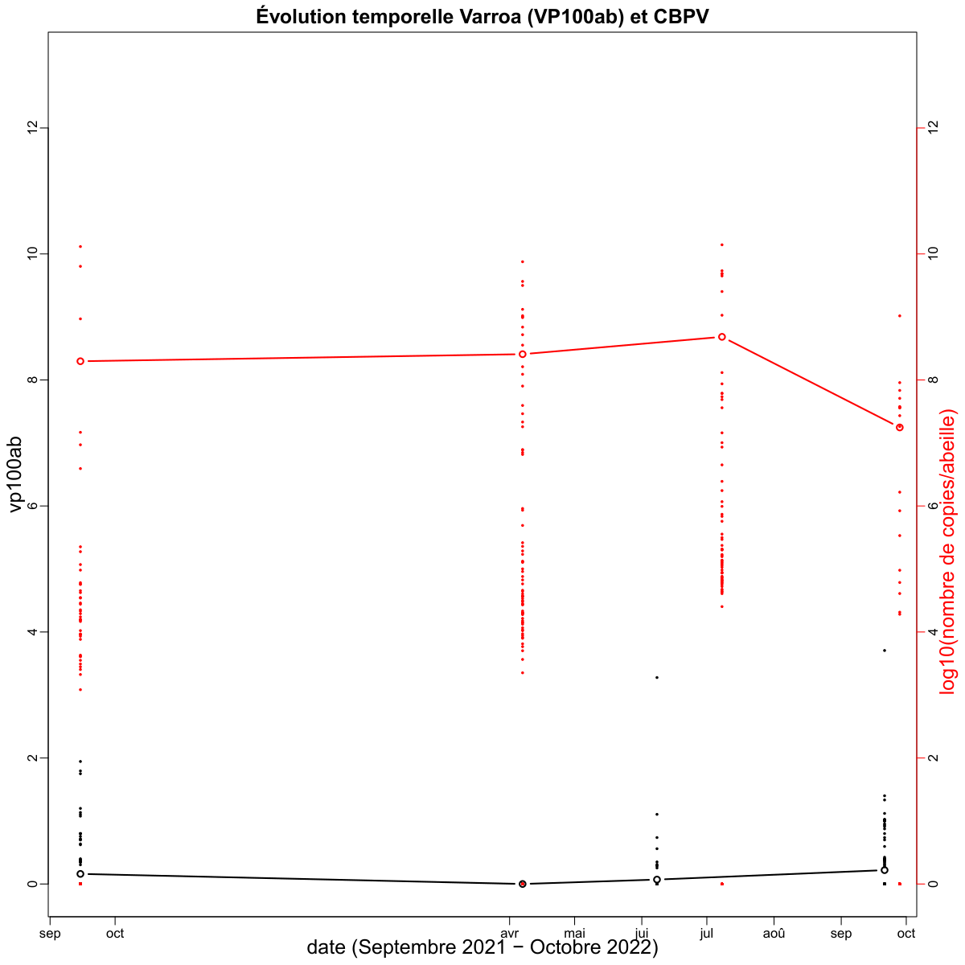
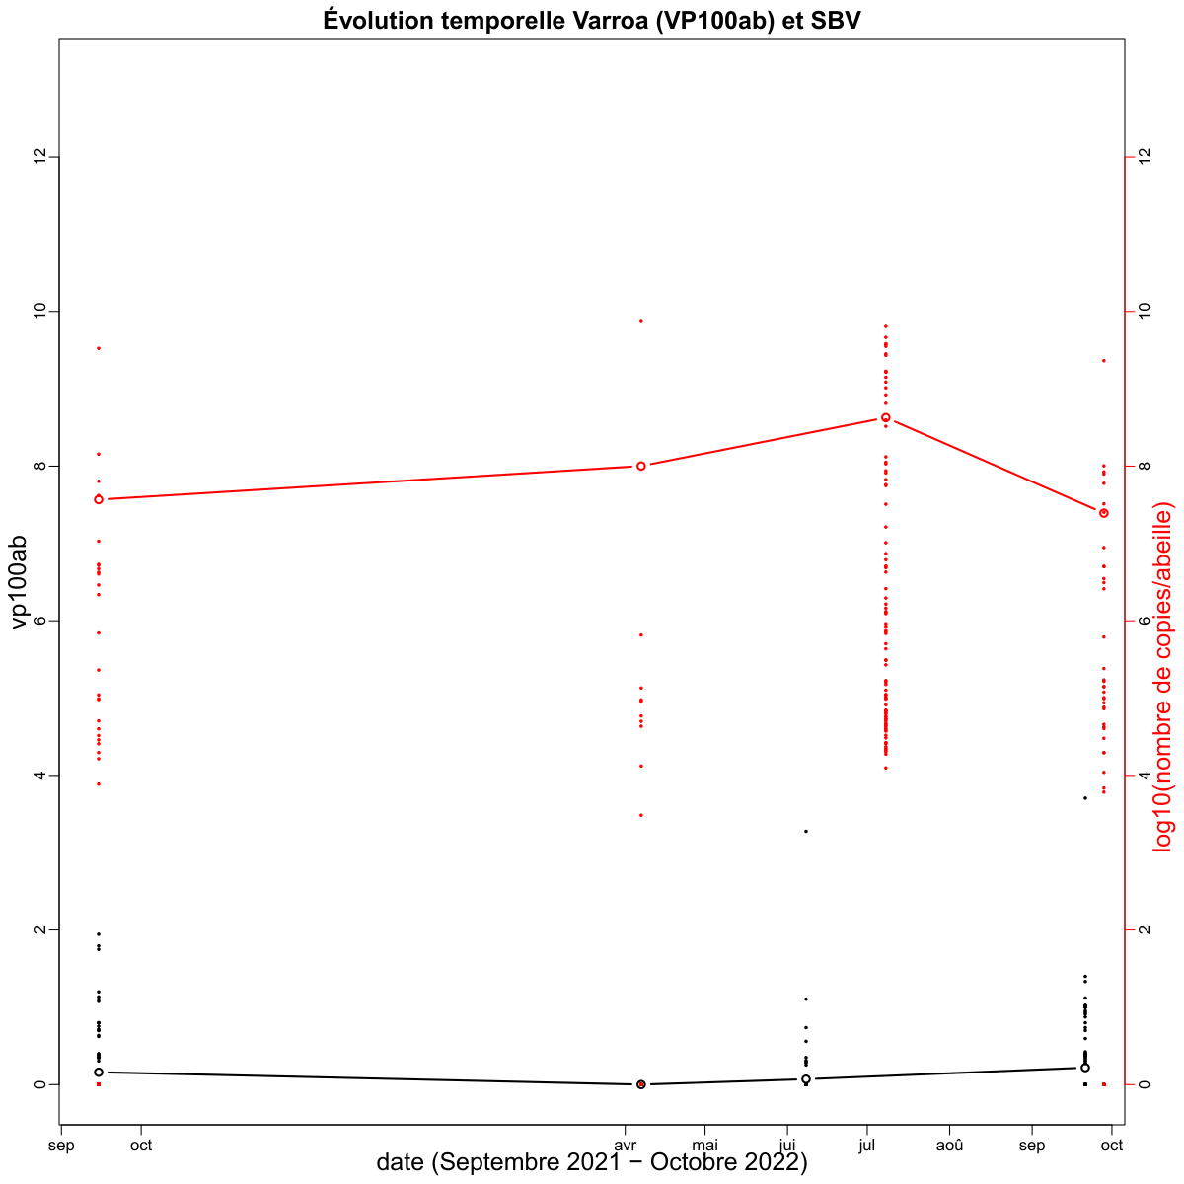
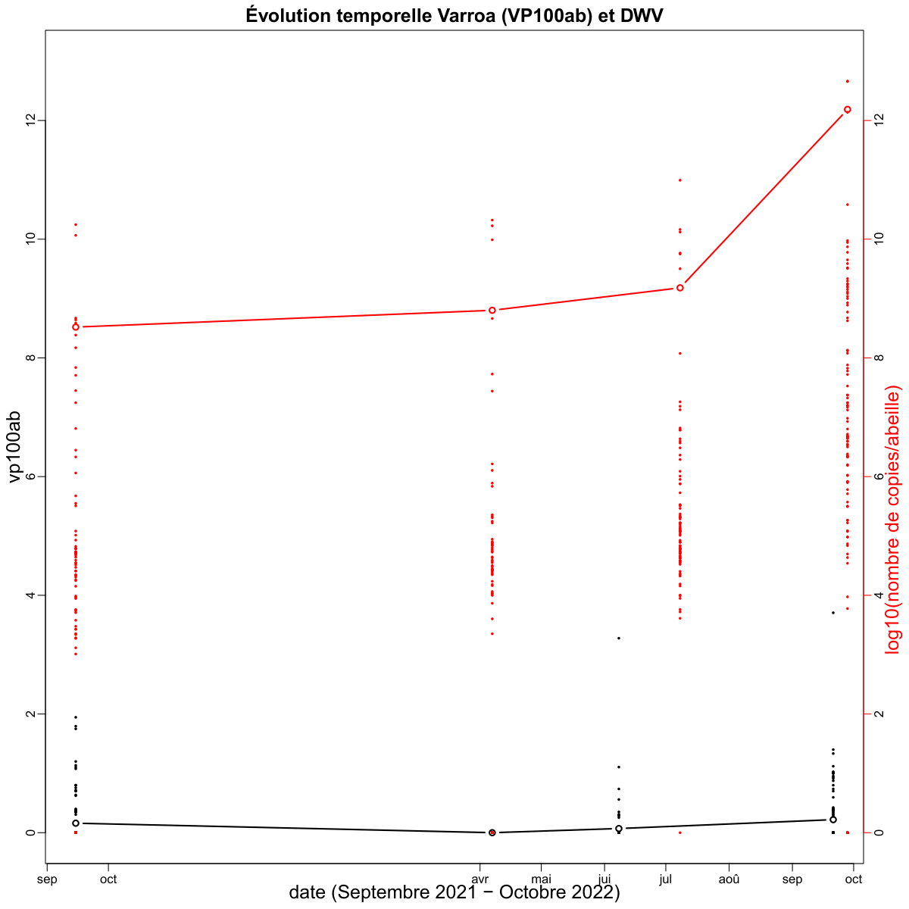
Résultats
Évolution temporelle Varroa et charge virale
ABPV
BQCV
CBPV
Varroa (Vp100ab)
Nombre de copie virus/abeille (log10)
SBV
DWV
Varroa (Vp100ab)
Nombre de copie virus/abeille (log10)
Notes:
Despite the defenses, Varroa has dramatic impacts on colonies in most cases.
These are attributed to the direct impact of V on individuals, but also, and maybe primarily to the association of the mite with several viruses.
…
Therefore, we can wonder what actually causes the pathogenic effects that are observed in the presnece of V.
…
The leads us to revise the conception of H/P relationship from a bilateral situation, to a 3 way relationship that included virus as a main actor.

Slide 19
Merci pour votre attention !
Grazie per l'attenzione !
http://w3.avignon.inra.fr/lavandes/biosp/APIN_ApinvernoFR.html

