Slide 1



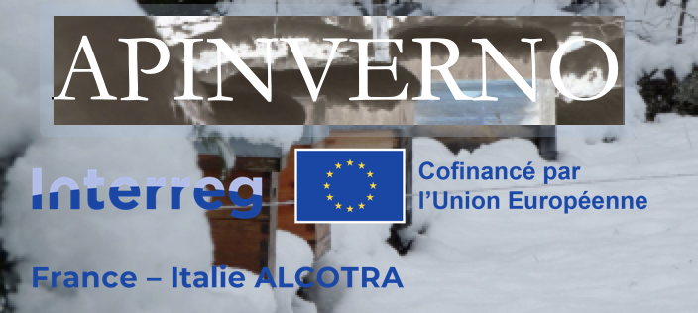

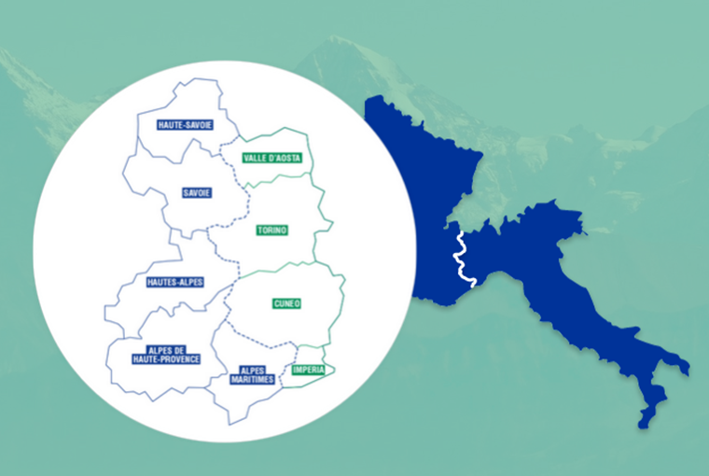



Quels effets d’un hivernage en montagne et d’un encagement hivernal sur la survie des colonies ?
Pelleautier : 11 janvier/gennaio 2024
Restitution finale / Incontro divulgativo finale

Slide 2

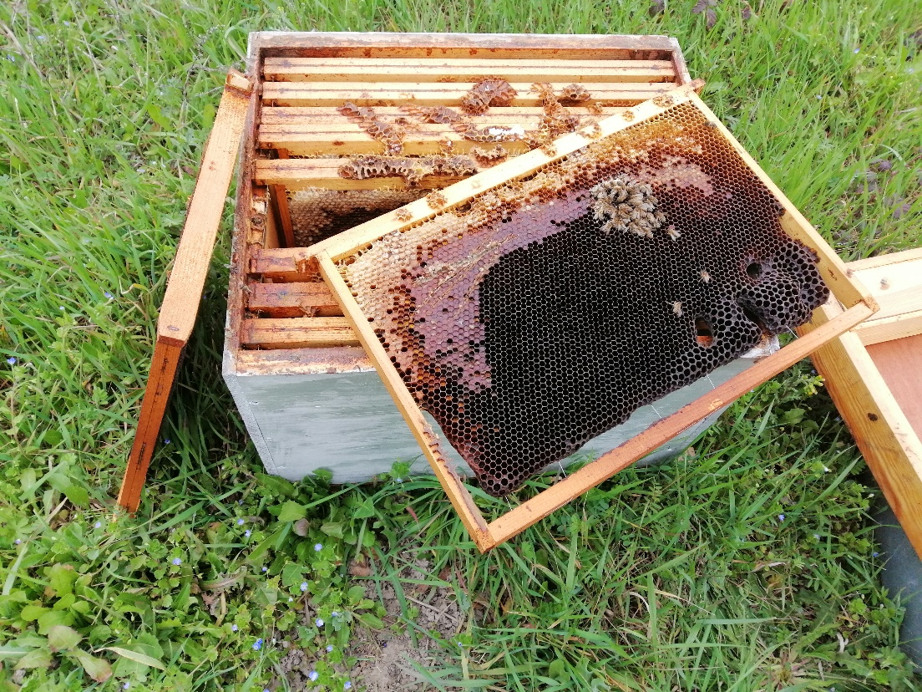
Des pertes de colonies liées aux stratégies de lutte contre Varroa ?
Définitions des pertes :
→ Colonies mortes
→ Colonies jugées NON-VALEUR par les apiculteurs
(population faible ou absence de développement )
Bilan des mortalités :
→ Sortie d’hiver (début mars)
→ Avant miellée d’été (juin)
2
Notes:
Despite the defenses, Varroa has dramatic impacts on colonies in most cases.
These are attributed to the direct impact of V on individuals, but also, and maybe primarily to the association of the mite with several viruses.
…
Therefore, we can wonder what actually causes the pathogenic effects that are observed in the presnece of V.
…
The leads us to revise the conception of H/P relationship from a bilateral situation, to a 3 way relationship that included virus as a main actor.

Slide 3
Tableau bilan des mortalités
3
Notes:
Despite the defenses, Varroa has dramatic impacts on colonies in most cases.
These are attributed to the direct impact of V on individuals, but also, and maybe primarily to the association of the mite with several viruses.
…
Therefore, we can wonder what actually causes the pathogenic effects that are observed in the presnece of V.
…
The leads us to revise the conception of H/P relationship from a bilateral situation, to a 3 way relationship that included virus as a main actor.

Slide 4
Lieu d’hivernage et survie :
années 1 & 2
Pas d’impact de l’hivernage en montagne sur la survie des colonies
Mortalité printanière moindre en Italie qu’en France sans lien avec la strtégie d’hivernage
4
Notes:
Despite the defenses, Varroa has dramatic impacts on colonies in most cases.
These are attributed to the direct impact of V on individuals, but also, and maybe primarily to the association of the mite with several viruses.
…
Therefore, we can wonder what actually causes the pathogenic effects that are observed in the presnece of V.
…
The leads us to revise the conception of H/P relationship from a bilateral situation, to a 3 way relationship that included virus as a main actor.

Slide 5
Encagement et survie :
années 1 & 2
Pas d’impact de l’encagement sur la survie des colonies
Mortalité printanière moindre en Italie qu’en France sans lien avec la stratégie d’encagement
5
Notes:
Despite the defenses, Varroa has dramatic impacts on colonies in most cases.
These are attributed to the direct impact of V on individuals, but also, and maybe primarily to the association of the mite with several viruses.
…
Therefore, we can wonder what actually causes the pathogenic effects that are observed in the presnece of V.
…
The leads us to revise the conception of H/P relationship from a bilateral situation, to a 3 way relationship that included virus as a main actor.

Slide 6
Bilan
Pas d’impact négatif des stratégies de lutte contre Varroa en hiver
(Encagement hivernal et hivernage en montagne) sur la survie des colonies
6
Notes:
Despite the defenses, Varroa has dramatic impacts on colonies in most cases.
These are attributed to the direct impact of V on individuals, but also, and maybe primarily to the association of the mite with several viruses.
…
Therefore, we can wonder what actually causes the pathogenic effects that are observed in the presnece of V.
…
The leads us to revise the conception of H/P relationship from a bilateral situation, to a 3 way relationship that included virus as a main actor.

Slide 7
Merci pour votre attention !
Grazie per l'attenzione !
http://w3.avignon.inra.fr/lavandes/biosp/APIN_ApinvernoFR.html

