Slide 1



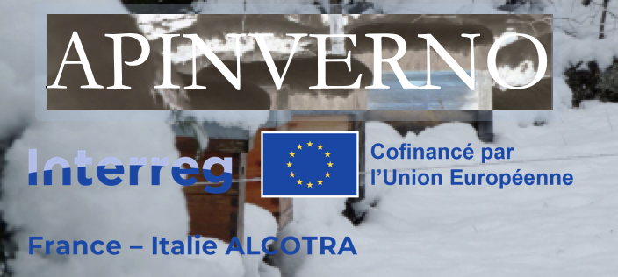

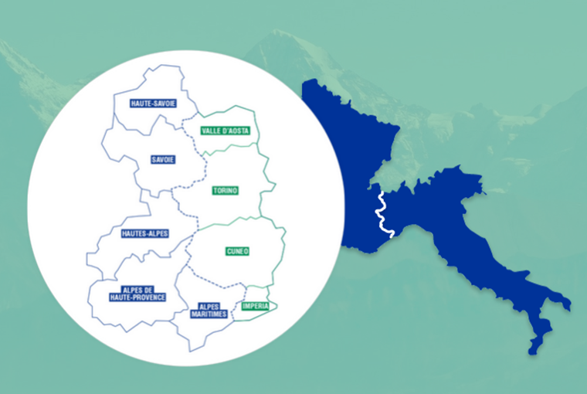



Quels impacts sur les réserves et la production de miel ?
Pelleautier : 11 janvier/gennaio 2024
Restitution finale / Incontro divulgativo finale

Slide 2

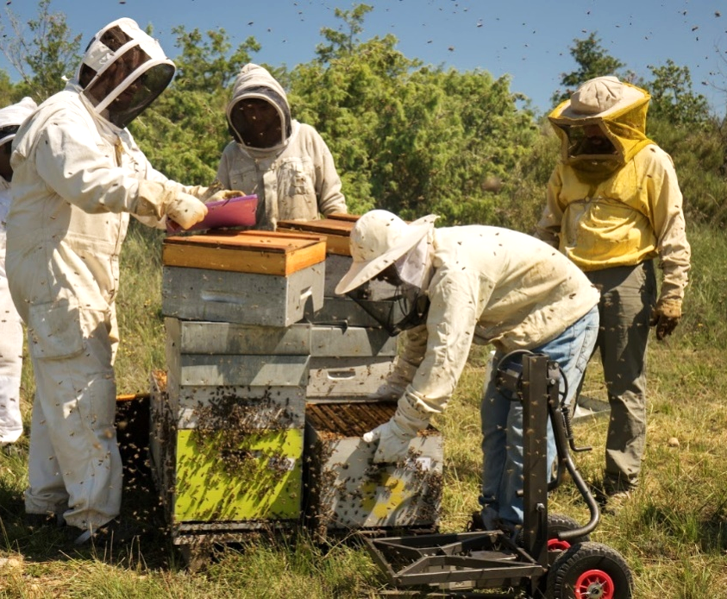
Quels impacts sur les réserves et la production de miel ?
8 ruchers suivis sur deux années dans deux pays
Pesées régulières des corps et des hausses
Evaluer l’impact du lieu d’hivernage et de l’encagement hivernal sur :
  → Les réserves de la colonie = poids des corps
  → La production de miel = gain de poids en hausse
Notes:
Despite the defenses, Varroa has dramatic impacts on colonies in most cases.
These are attributed to the direct impact of V on individuals, but also, and maybe primarily to the association of the mite with several viruses.
…
Therefore, we can wonder what actually causes the pathogenic effects that are observed in the presnece of V.
…
The leads us to revise the conception of H/P relationship from a bilateral situation, to a 3 way relationship that included virus as a main actor.

Slide 3
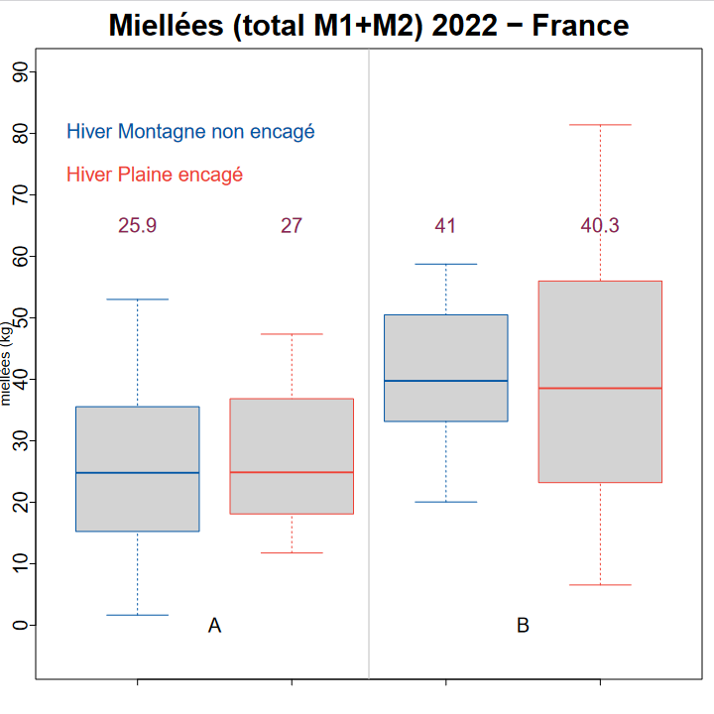
Quels impacts sur les réserves et la production de miel ?
Notes:
Despite the defenses, Varroa has dramatic impacts on colonies in most cases.
These are attributed to the direct impact of V on individuals, but also, and maybe primarily to the association of the mite with several viruses.
…
Therefore, we can wonder what actually causes the pathogenic effects that are observed in the presnece of V.
…
The leads us to revise the conception of H/P relationship from a bilateral situation, to a 3 way relationship that included virus as a main actor.

Slide 4
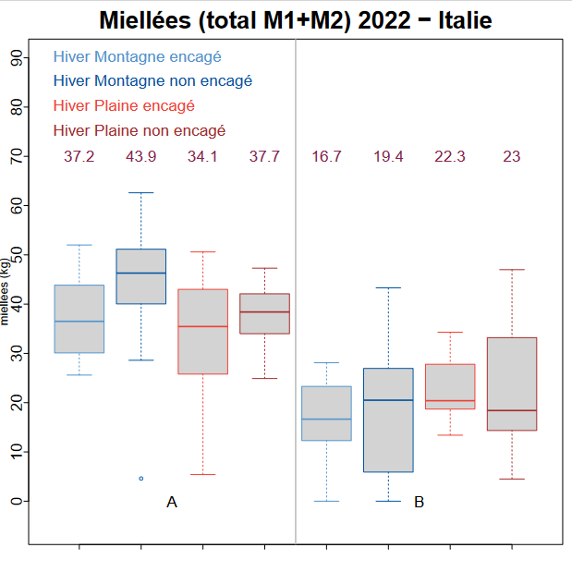
Quels impacts sur les réserves et la production de miel ?
Notes:
Despite the defenses, Varroa has dramatic impacts on colonies in most cases.
These are attributed to the direct impact of V on individuals, but also, and maybe primarily to the association of the mite with several viruses.
…
Therefore, we can wonder what actually causes the pathogenic effects that are observed in the presnece of V.
…
The leads us to revise the conception of H/P relationship from a bilateral situation, to a 3 way relationship that included virus as a main actor.

Slide 5
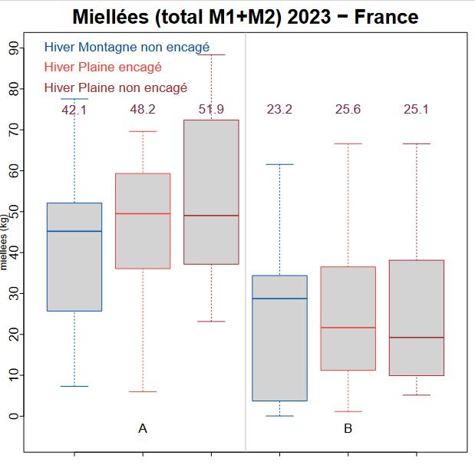
Quels impacts sur les réserves et la production de miel ?
Notes:
Despite the defenses, Varroa has dramatic impacts on colonies in most cases.
These are attributed to the direct impact of V on individuals, but also, and maybe primarily to the association of the mite with several viruses.
…
Therefore, we can wonder what actually causes the pathogenic effects that are observed in the presnece of V.
…
The leads us to revise the conception of H/P relationship from a bilateral situation, to a 3 way relationship that included virus as a main actor.

Slide 6
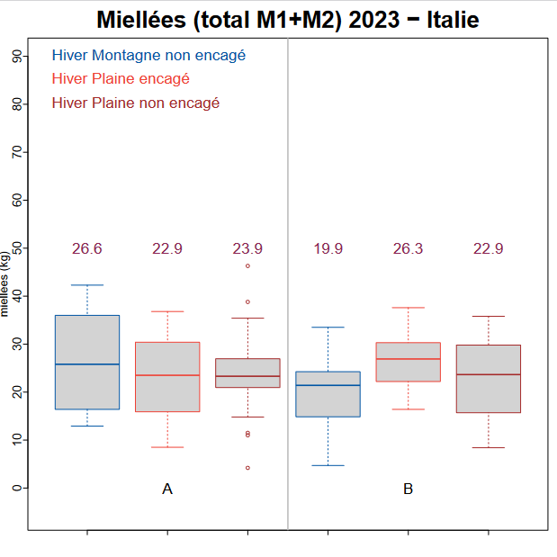
Quels impacts sur les réserves et la production de miel ?
Notes:
Despite the defenses, Varroa has dramatic impacts on colonies in most cases.
These are attributed to the direct impact of V on individuals, but also, and maybe primarily to the association of the mite with several viruses.
…
Therefore, we can wonder what actually causes the pathogenic effects that are observed in the presnece of V.
…
The leads us to revise the conception of H/P relationship from a bilateral situation, to a 3 way relationship that included virus as a main actor.

Slide 7
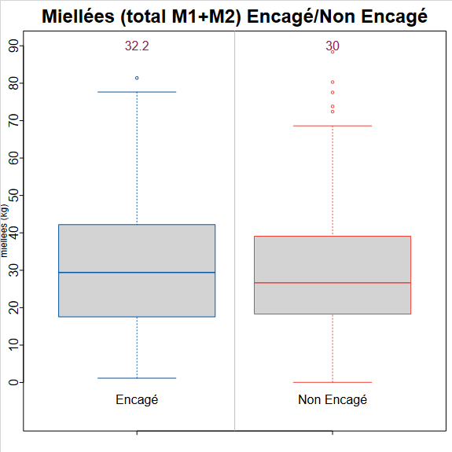
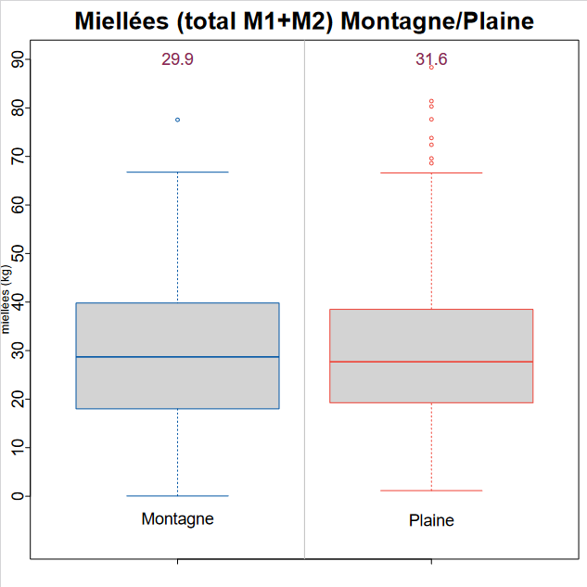
Quels impacts sur les réserves et la production de miel ?
Sur l’ensemble des 8 ruchers des deux années dans les deux pays, le lieux d’hivernage ainsi que la modalité de traitements n’ont aucun impacte sur la production de miel
Sur les 8 ruchers suivis ces deux années en France et en Italie, aucun n’a suivi un itinéraire technique visant a produire un miel tôt en saison (romarin, bruyère…)
Quid d’une miellée précoce ?
Notes:
Despite the defenses, Varroa has dramatic impacts on colonies in most cases.
These are attributed to the direct impact of V on individuals, but also, and maybe primarily to the association of the mite with several viruses.
…
Therefore, we can wonder what actually causes the pathogenic effects that are observed in the presnece of V.
…
The leads us to revise the conception of H/P relationship from a bilateral situation, to a 3 way relationship that included virus as a main actor.

Slide 8
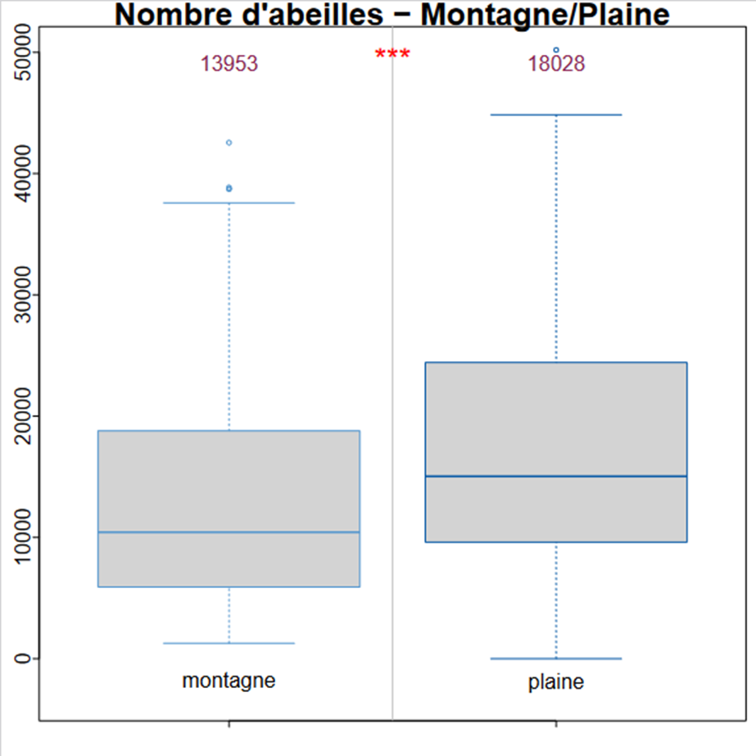
Quels impacts sur les réserves et la production de miel ?
En sortie d’hiver (mars 2022 et 2023), le nombre d’abeilles des colonies hivernées en montagne est significativement plus faible que celui des ruches hivernées en plaine
Les ruches hivernées en montagne pourraient être moins performantes sur miellée précoce
Notes:
Despite the defenses, Varroa has dramatic impacts on colonies in most cases.
These are attributed to the direct impact of V on individuals, but also, and maybe primarily to the association of the mite with several viruses.
…
Therefore, we can wonder what actually causes the pathogenic effects that are observed in the presnece of V.
…
The leads us to revise the conception of H/P relationship from a bilateral situation, to a 3 way relationship that included virus as a main actor.

Slide 9
Merci pour votre attention !
Grazie per l'attenzione !
http://w3.avignon.inra.fr/lavandes/biosp/APIN_ApinvernoFR.html

