Slide 1



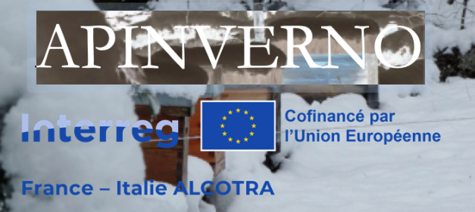




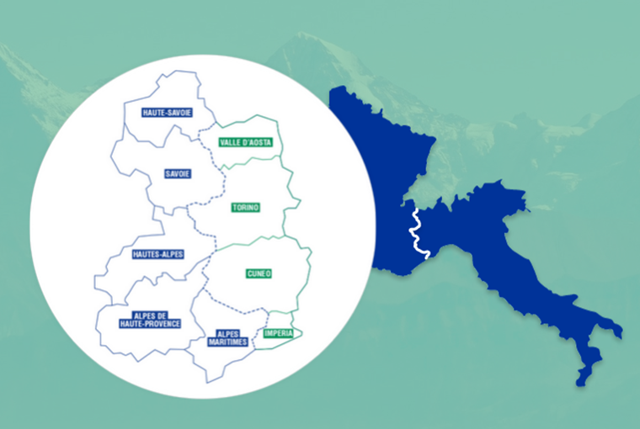
Quels effets d’un hivernage en montagne sur le développement printanier des colonies?
Quali possono essere gli effetti di un invernamento in montagna sullo sviluppo primaverile degli alveri?
Pelleautier : 11 janvier/gennaio 2024
Restitution finale / Incontro divulgativo finale

Slide 2
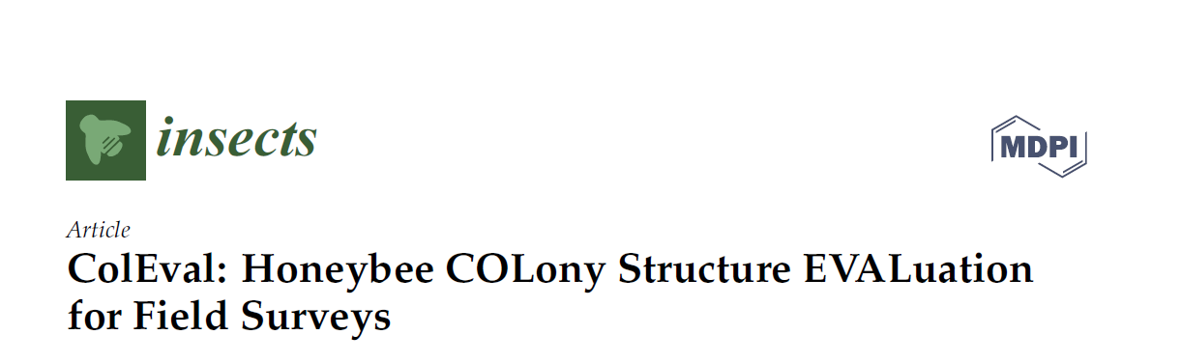
Chi l’ha ‘messo a punto’?
Qui l’a mis au point ?
ColEval (metodo di valutazione della colonia) è stato sviluppato in Francia, sulla base di osservazioni pluriennali delle colonie durante il raccolto della lavanda - ColEval (méthode d’évaluation de la colonie) a été développé en France, sur la base d’observations pluriannuelles des colonies pendant la récolte de lavande (Apimodel, Kretzschmar & Maisonnasse 2014)
Hernandez, Julie et al.- Coleval : Honeybee COLony structure EVALuation for field survey - Insects 2020, 11(1), 41; https://doi.org/10.3390/insects11010041
Sito internet: http://w3.avignon.inra.fr/lavandes/biosp/ColevalTraining.html
Youtube: https://www.youtube.com/channel/UCcSpLiiJJnJc9SQ9Q56104A/featured

Slide 3
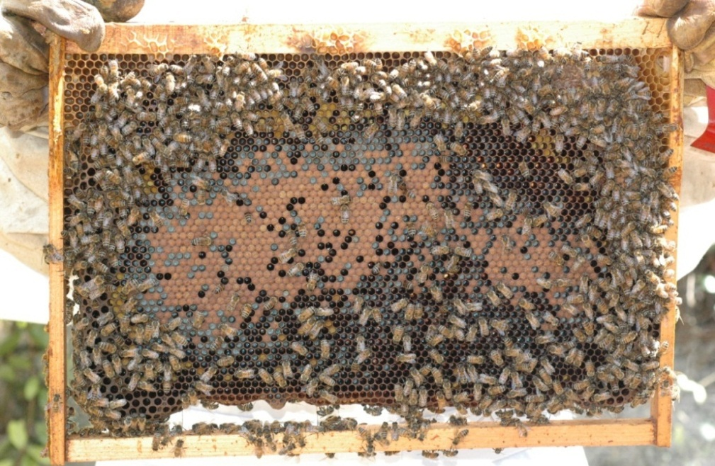
ColEval: principi
ColEval : principes
1 lato - côté = 100%
100% viene considerato ‘da legno a legno’ anche se il favo non è costruito - 100% est considéré comme 'bois à bois' même si le nid d’abeilles n’est pas construit

Slide 4
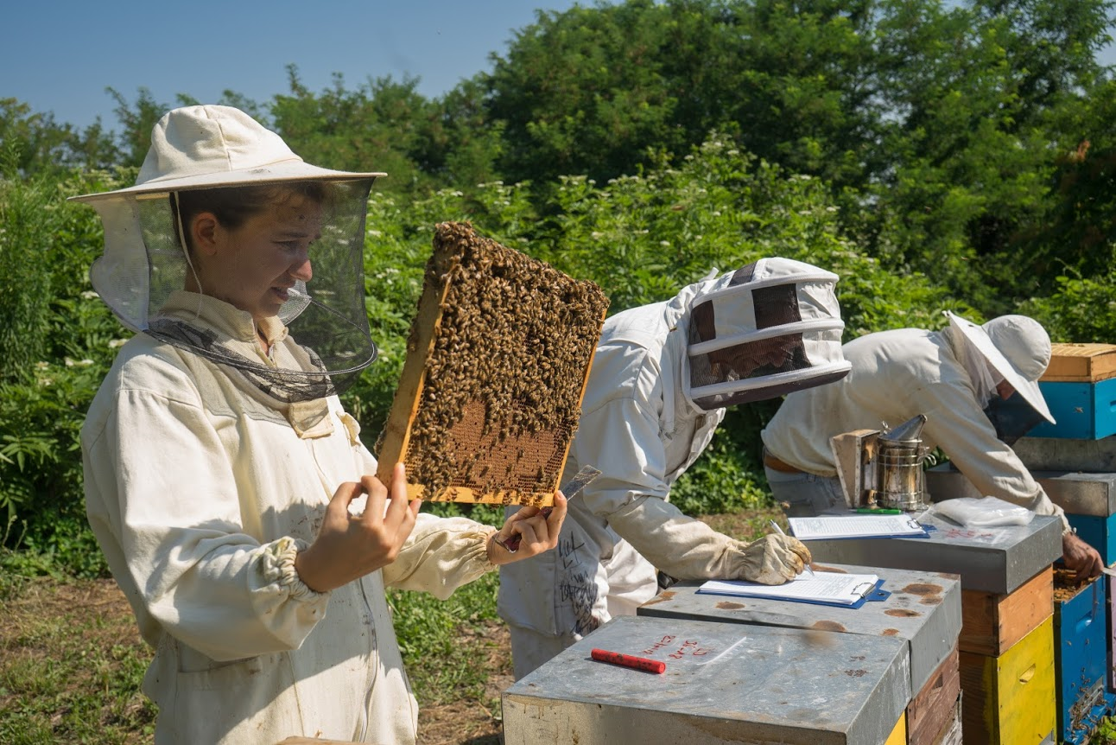
ColEval: principi
ColEval : principes
Il metodo si basa sulla valutazione della % di copertura di:
La méthode repose sur l’évaluation du % de couverture de:
Api - abeilles
Covata opercolata- couvain operculée,
Covata fresca - fraîche,
Miele - miel,
Polline - pollen,
Covata da fuco – couvain mâle???
La valutazione viene effettuata su entrambe le facciate di tutti i telai (valori di 5 in 5)
L’évaluation est effectuée sur les deux faces de tous les cadres (valeurs de 5 en 5)

Slide 5

2022 en France
Abeilles & couvain fermé
Notes:
Despite the defenses, Varroa has dramatic impacts on colonies in most cases.
These are attributed to the direct impact of V on individuals, but also, and maybe primarily to the association of the mite with several viruses.
…
Therefore, we can wonder what actually causes the pathogenic effects that are observed in the presnece of V.
…
The leads us to revise the conception of H/P relationship from a bilateral situation, to a 3 way relationship that included virus as a main actor.

Slide 6
2023 en France
Abeilles & couvain fermé
Notes:
Despite the defenses, Varroa has dramatic impacts on colonies in most cases.
These are attributed to the direct impact of V on individuals, but also, and maybe primarily to the association of the mite with several viruses.
…
Therefore, we can wonder what actually causes the pathogenic effects that are observed in the presnece of V.
…
The leads us to revise the conception of H/P relationship from a bilateral situation, to a 3 way relationship that included virus as a main actor.

Slide 7
2022 en Italie :
Abeilles & couvain fermé
Notes:
Despite the defenses, Varroa has dramatic impacts on colonies in most cases.
These are attributed to the direct impact of V on individuals, but also, and maybe primarily to the association of the mite with several viruses.
…
Therefore, we can wonder what actually causes the pathogenic effects that are observed in the presnece of V.
…
The leads us to revise the conception of H/P relationship from a bilateral situation, to a 3 way relationship that included virus as a main actor.

Slide 8
2023 en Italie
Abeilles & couvain fermé
Notes:
Despite the defenses, Varroa has dramatic impacts on colonies in most cases.
These are attributed to the direct impact of V on individuals, but also, and maybe primarily to the association of the mite with several viruses.
…
Therefore, we can wonder what actually causes the pathogenic effects that are observed in the presnece of V.
…
The leads us to revise the conception of H/P relationship from a bilateral situation, to a 3 way relationship that included virus as a main actor.

Slide 9
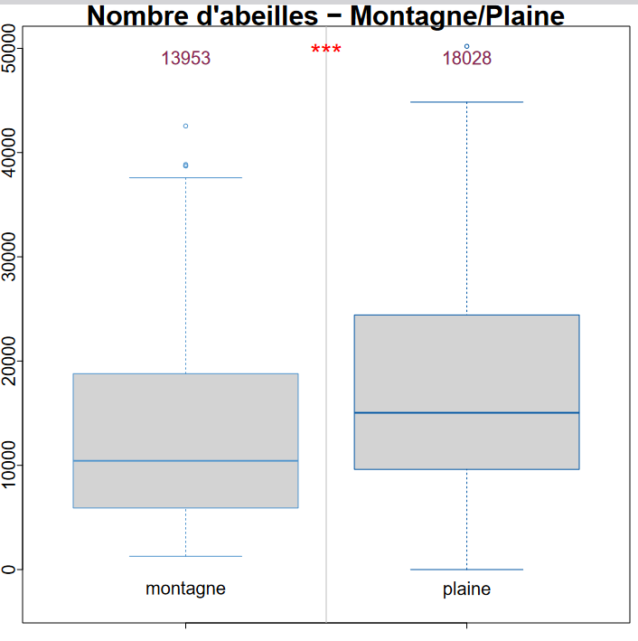
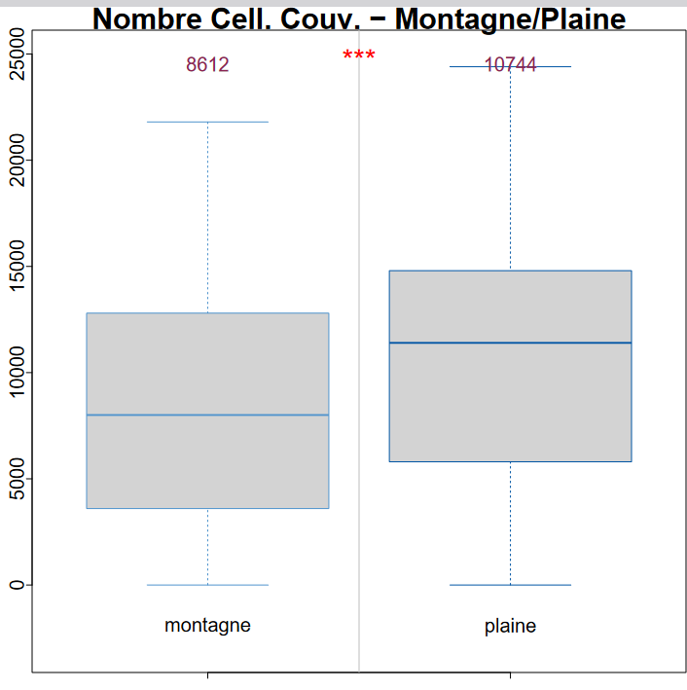
Bilancio generale all’uscita dall’inverno
Bilan général à la sortie de l’hiver
Un piccolo effetto sulla popolazione a marzo che sparisce a giugno
Un petit effet sur la population en mars qui disparaît en juin

Slide 10
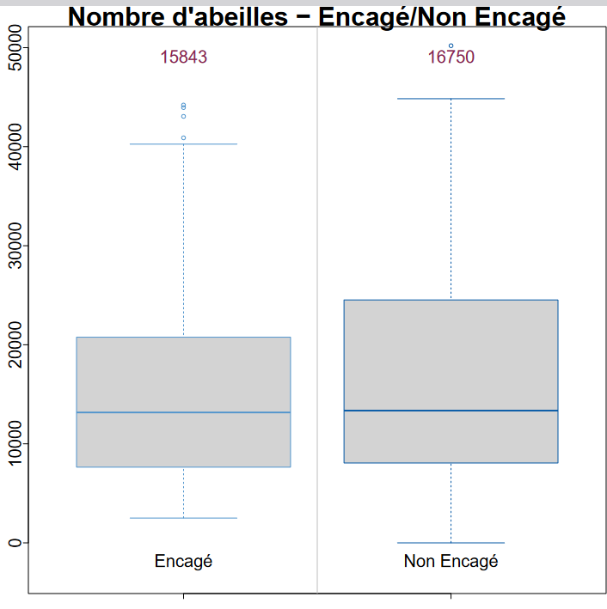
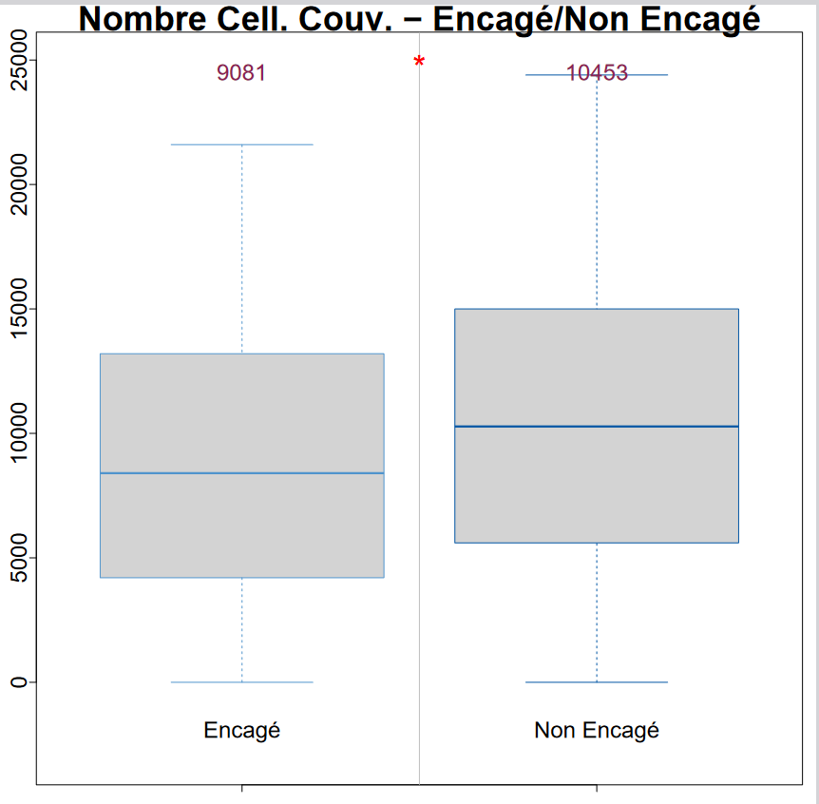
Bilancio generale all’uscita dall’inverno
Bilan général à la sortie de l’hiver
Praticamente nessuna differenza sulla covata in marzo
Pratiquement aucune différence sur la couvée en mars

Slide 11
Merci pour votre attention !
Grazie per l'attenzione !
http://w3.avignon.inra.fr/lavandes/biosp/APIN_ApinvernoFR.html

Slide 12
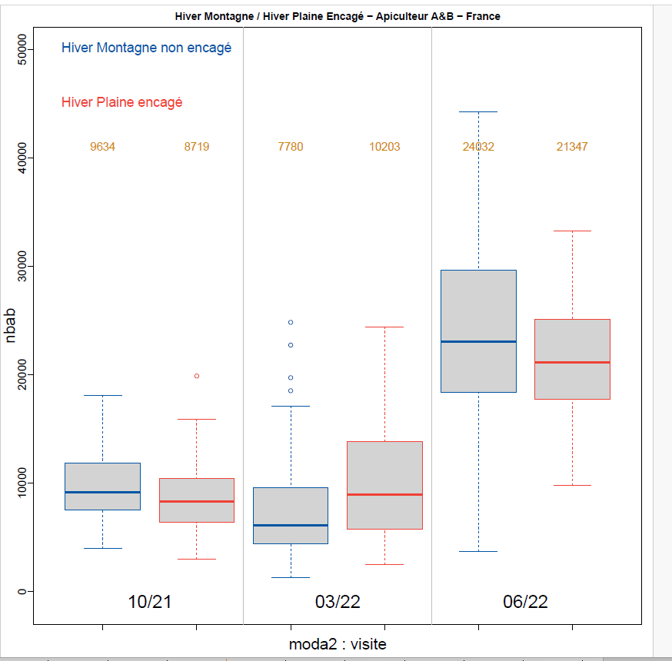
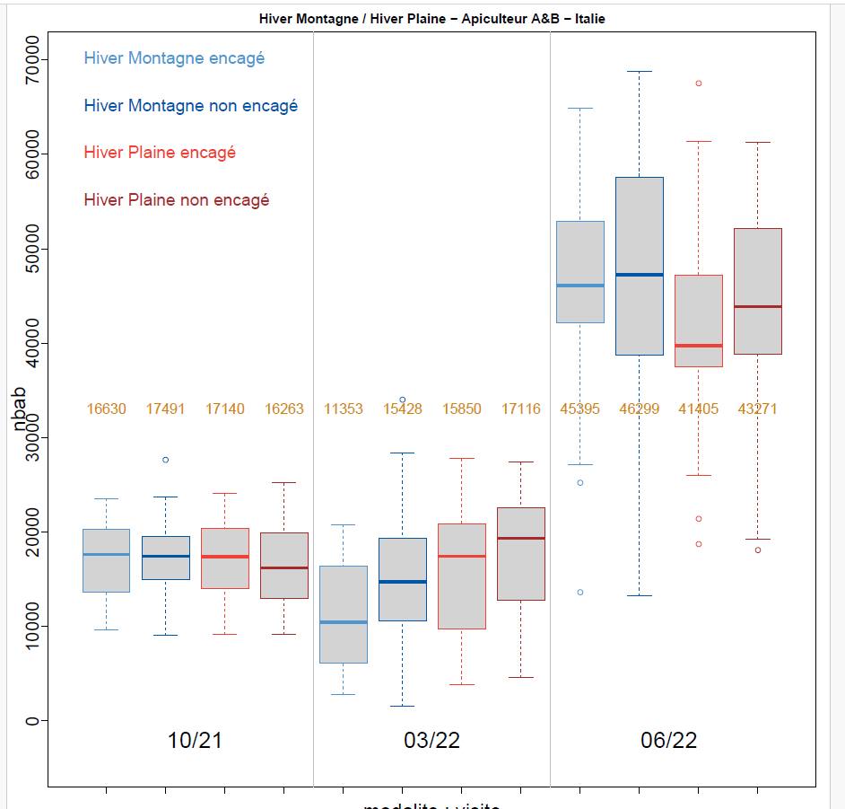
Api primo inverno
Abeilles premier hiver
Alveari un po’ più ridotti in montagna all’uscita dall’inverno
Alveari un po’ più ridotti in montagna e ingabbiati all’uscita dall’inverno

Slide 13
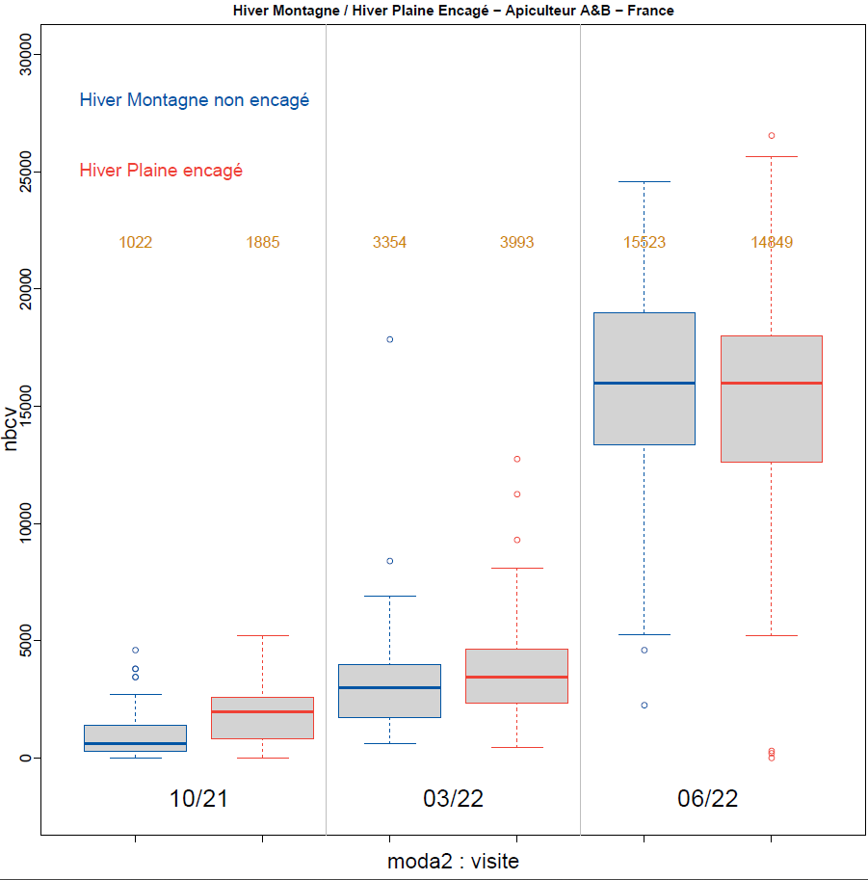
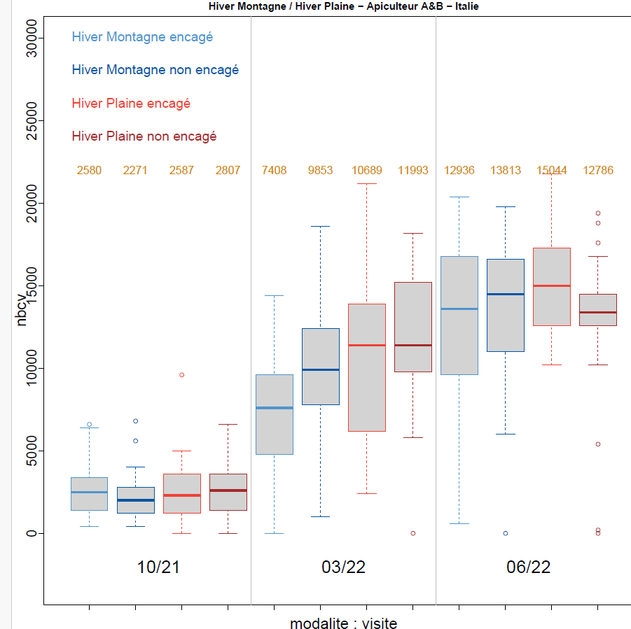
Covata primo inverno
Couvain premier hiver
Primavera - Covata ridotta in montagna-ingabbiate

Slide 14
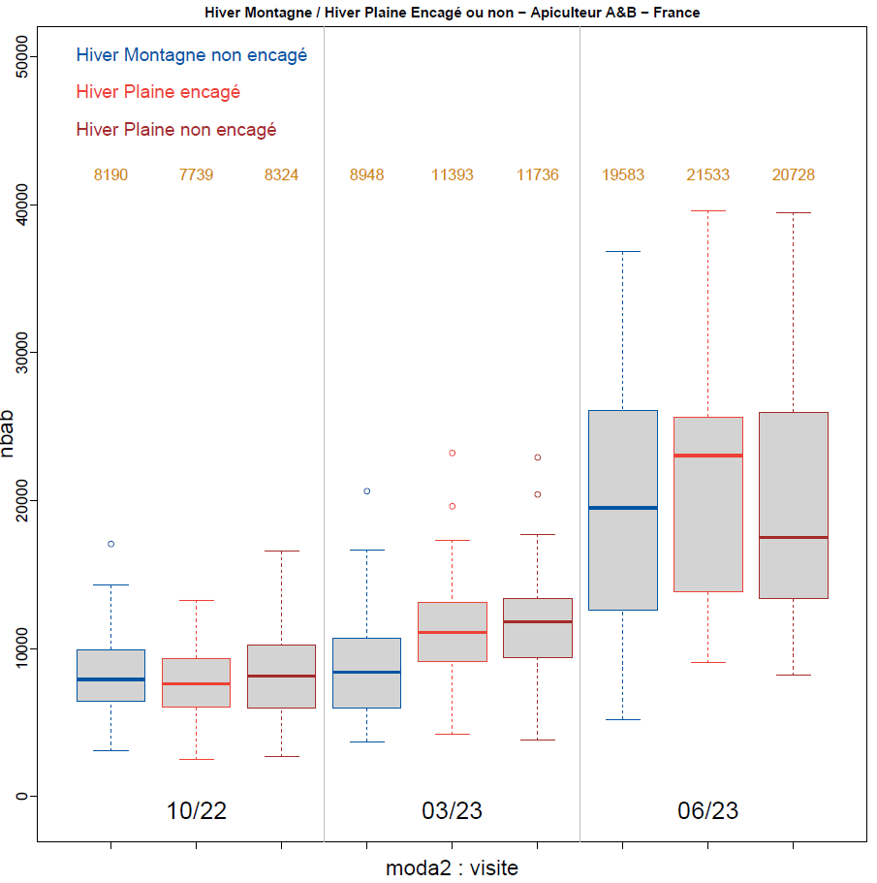
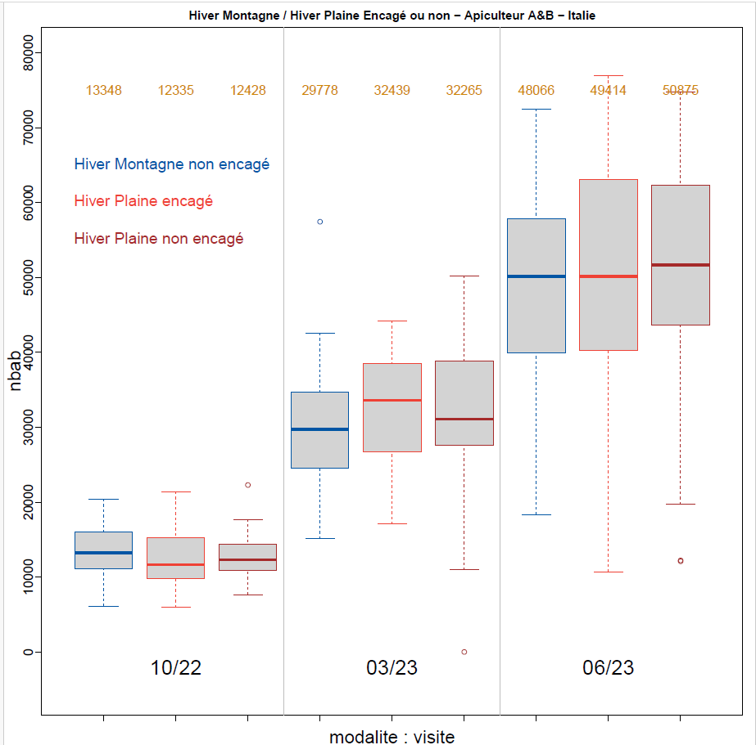
Api secondo inverno
Abeilles second hiver
Alveari un po’ più ridotti in montagna all’uscita dall’inverno
Alveari un po’ più ridotti in montagna e ingabbiati all’uscita dall’inverno

Slide 15
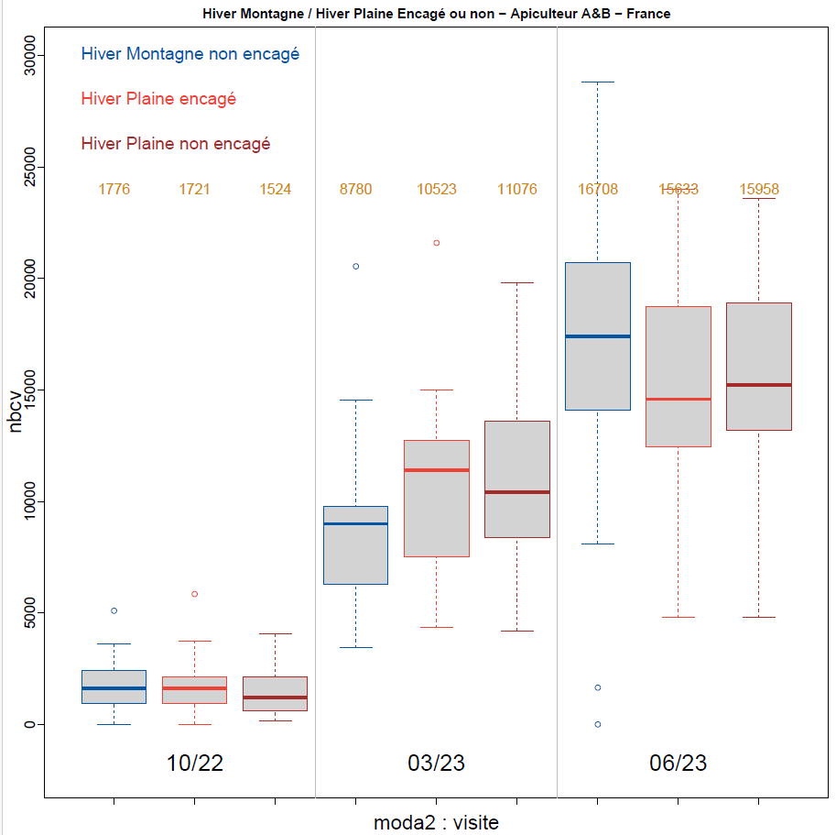
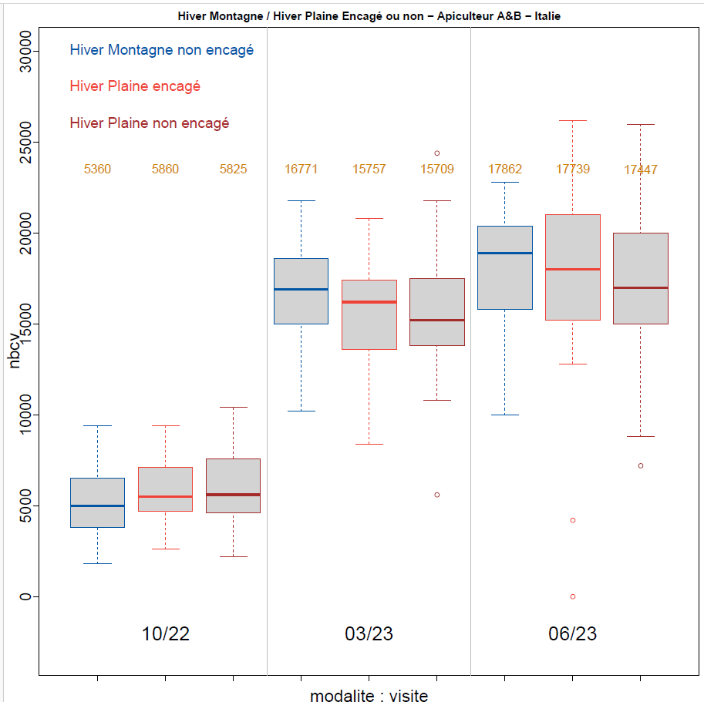
Covata secondo inverno
Couvain second hiver

Slide 16
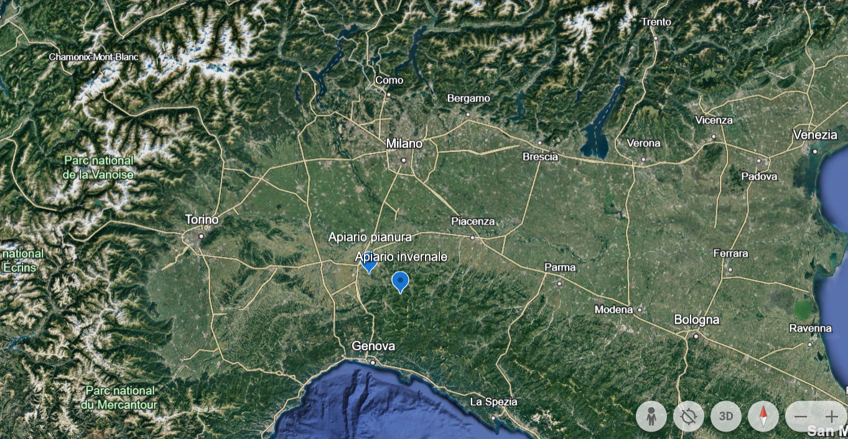
Apiario di montagna negli Appennini (700 m slm)
Apiario di pianura vicino alla Pianura Padana (170 m slm)
Rucher de mantagne dans les Apennins (700 m d’altitude)
Rucher de plaine près de la plaine du Pô (170 m d’altitude)

Slide 17
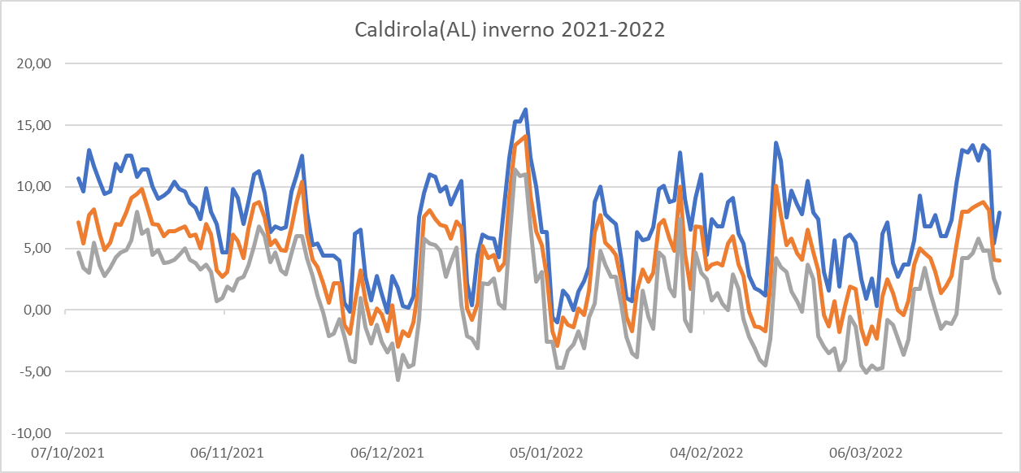
Se l’inverno non arriva… sempre più necessario il blocco artificiale
Si l’hiver ne vient pas... de plus en plus nécessaire le bloc artificiel
T max
T media
T min

