Slide 1


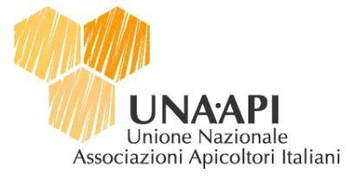
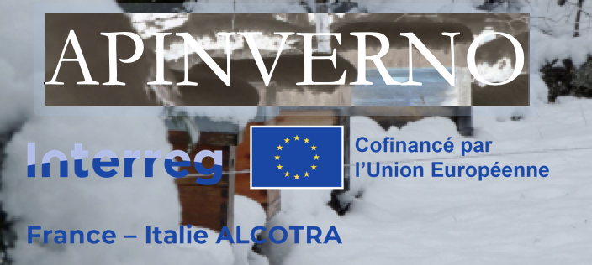

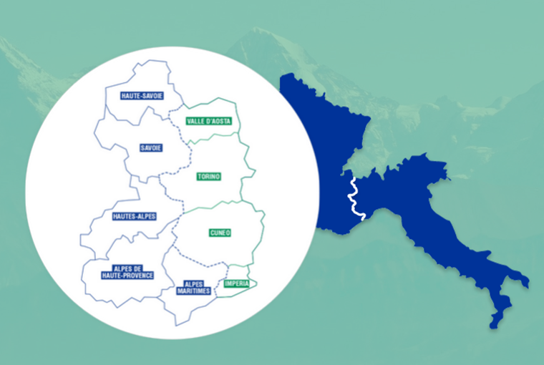
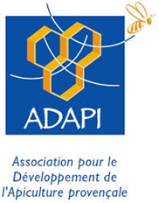


Varroa : Quels sont les effets des stratégies de lutte hivernale sur les charges parasitaires au cours de la saison apicole ?
Pelleautier : 11 janvier/gennaio 2024
Restitution finale / Incontro divulgativo finale

Slide 2


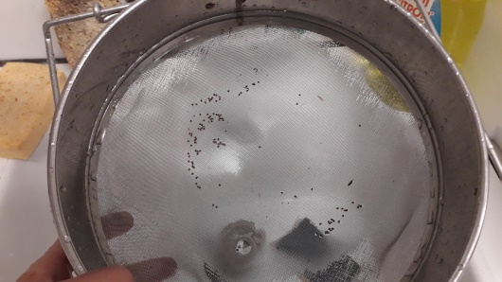
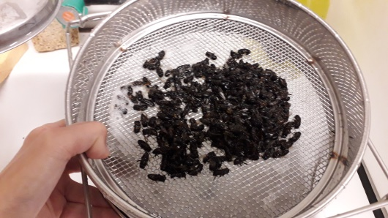
Comment mesurer
l’infestation Varroa ?
Un indicateur : Le taux de Varroas Phorétiques / 100 abeilles
→ Varroa phorétique = varroa sur les abeilles adultes
→ Méthode :
  Prélèvement d’abeilles (±300 ab ≈ 100 mL ≈ 40g)
  Lavage des abeilles au détergent et comptages des varroas
  Détermination du nombre de VP/100ab
Lavage des abeilles et comptage des varroas
2
Notes:
Despite the defenses, Varroa has dramatic impacts on colonies in most cases.
These are attributed to the direct impact of V on individuals, but also, and maybe primarily to the association of the mite with several viruses.
…
Therefore, we can wonder what actually causes the pathogenic effects that are observed in the presnece of V.
…
The leads us to revise the conception of H/P relationship from a bilateral situation, to a 3 way relationship that included virus as a main actor.

Slide 3
Taux de Varroas dans les ruchers français : année 1 & 2
Des taux de Varroas phorétiques identiques
2 stratégie efficaces :
→ hivernage en montagne sans encagement & en plaine avec encagement
3
Notes:
Despite the defenses, Varroa has dramatic impacts on colonies in most cases.
These are attributed to the direct impact of V on individuals, but also, and maybe primarily to the association of the mite with several viruses.
…
Therefore, we can wonder what actually causes the pathogenic effects that are observed in the presnece of V.
…
The leads us to revise the conception of H/P relationship from a bilateral situation, to a 3 way relationship that included virus as a main actor.

Slide 4
Taux de Varroas dans les ruchers italiens : année 1 & 2
Des taux de Varroas phorétiques identiques et très faibles en Italie
4 stratégie efficaces :
→ hivernage en montagne & en plaine avec/sans encagement
4
Notes:
Despite the defenses, Varroa has dramatic impacts on colonies in most cases.
These are attributed to the direct impact of V on individuals, but also, and maybe primarily to the association of the mite with several viruses.
…
Therefore, we can wonder what actually causes the pathogenic effects that are observed in the presnece of V.
…
The leads us to revise the conception of H/P relationship from a bilateral situation, to a 3 way relationship that included virus as a main actor.

Slide 5
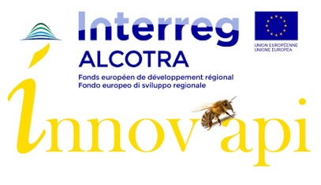
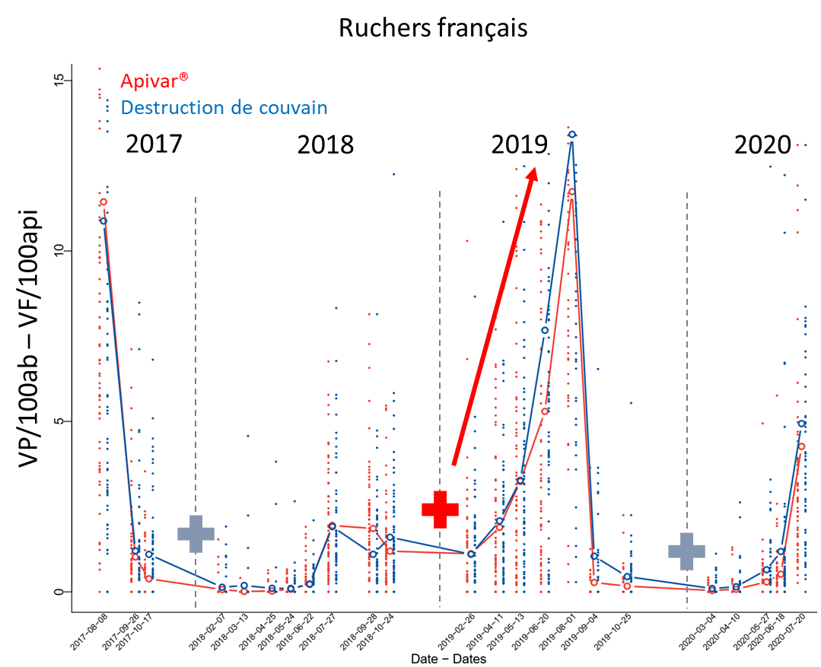
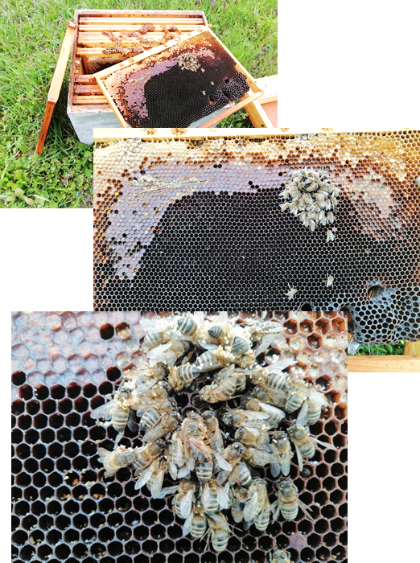
Bilan des stratégies de lutte contre Varroa en hiver
Toutes les stratégies se valent
Attention : traitement efficaces sur stratégies non encagement
→ hiver froids les 2 années de l’essai en plaine = Ruptures naturelles de couvain
Hiverner en montagne ou encager en pleine = garantie d’un traitement efficace
Traiter à l’aveugle dans des environnements où les hivers peuvent être chaud, c’est risquer de faire un traitement inefficace ! ….. l’expérience d’Innov’api
État des ruchers en sortie d'hivernage 2020
5
Notes:
Despite the defenses, Varroa has dramatic impacts on colonies in most cases.
These are attributed to the direct impact of V on individuals, but also, and maybe primarily to the association of the mite with several viruses.
…
Therefore, we can wonder what actually causes the pathogenic effects that are observed in the presnece of V.
…
The leads us to revise the conception of H/P relationship from a bilateral situation, to a 3 way relationship that included virus as a main actor.

Slide 6
Merci pour votre attention !
Grazie per l'attenzione !
http://w3.avignon.inra.fr/lavandes/biosp/APIN_ApinvernoFR.html

