Slide 1



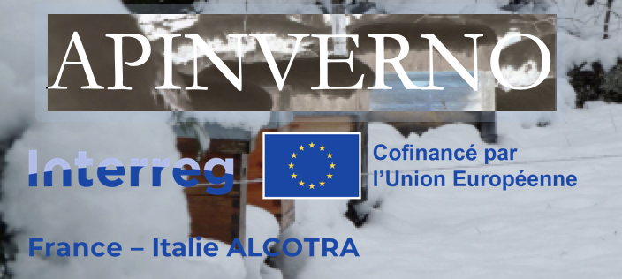

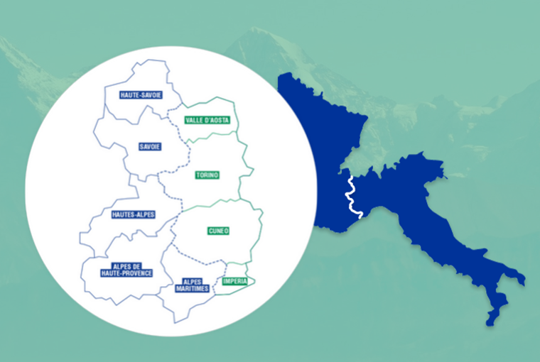



Dispositif expérimental d’APINVERNO
Pelleautier : 11 janvier/gennaio 2024
Restitution finale / Incontro divulgativo finale

Slide 2

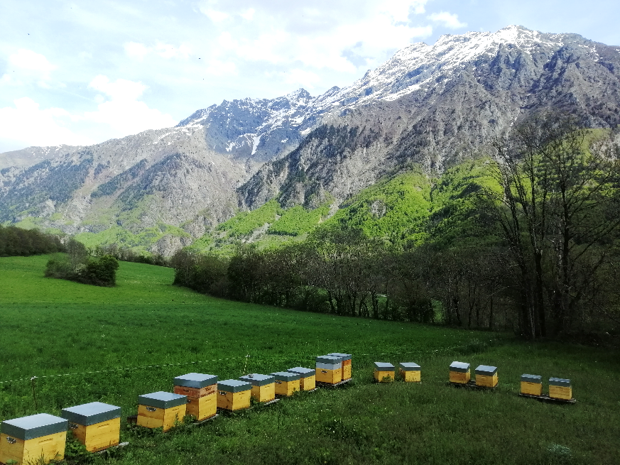
APINVERNO
Evaluation de plusieurs stratégies de lutte contre Varroa en hiver
Favoriser la rupture de couvain → optimisation des traitements contre Varroa
Influence du lieu d’hivernage
→ Différents contextes climatiques :
        Plaine/Littoral
        Montagne
Encagement de reines pour maîtriser/homogénéiser l’arrêt de ponte
2 années d’études
4 apiculteurs (2 Fr & 2 It) = 4 ruchers de 60 colonies → 240 colonies suivies
2
Notes:
Despite the defenses, Varroa has dramatic impacts on colonies in most cases.
These are attributed to the direct impact of V on individuals, but also, and maybe primarily to the association of the mite with several viruses.
…
Therefore, we can wonder what actually causes the pathogenic effects that are observed in the presnece of V.
…
The leads us to revise the conception of H/P relationship from a bilateral situation, to a 3 way relationship that included virus as a main actor.

Slide 3
Dispositif expérimental : année 1
En Italie et en France : 4 ruchers de 60 colonies : 240 colonies
2 en Italie :
2 en France :
15 encagement
30 hiver en montagne
60 colonies
après la miellée
de châtaignier
15 sans encagement
X 2
ruchers
15 encagement
30 hiver en plaine
15 sans encagement
Rucher 1
60 miellée en montagne
30 hiver en montagne sans encagement
Rucher 2
60 miellée sur lavandes
30 hiver en plaine avec encagement
3
Notes:
Despite the defenses, Varroa has dramatic impacts on colonies in most cases.
These are attributed to the direct impact of V on individuals, but also, and maybe primarily to the association of the mite with several viruses.
…
Therefore, we can wonder what actually causes the pathogenic effects that are observed in the presnece of V.
…
The leads us to revise the conception of H/P relationship from a bilateral situation, to a 3 way relationship that included virus as a main actor.

Slide 4
Dispositif expérimental : année 2
En Italie et en France : 4 ruchers de 60 colonies : 240 colonies
En Italie et en France :
20 hiver en montagne
Sans encagement
60 colonies
Avec reine de l’année
20 sans encagement
40 hiver en plaine
20 avec encagement
4
Notes:
Despite the defenses, Varroa has dramatic impacts on colonies in most cases.
These are attributed to the direct impact of V on individuals, but also, and maybe primarily to the association of the mite with several viruses.
…
Therefore, we can wonder what actually causes the pathogenic effects that are observed in the presnece of V.
…
The leads us to revise the conception of H/P relationship from a bilateral situation, to a 3 way relationship that included virus as a main actor.

Slide 5
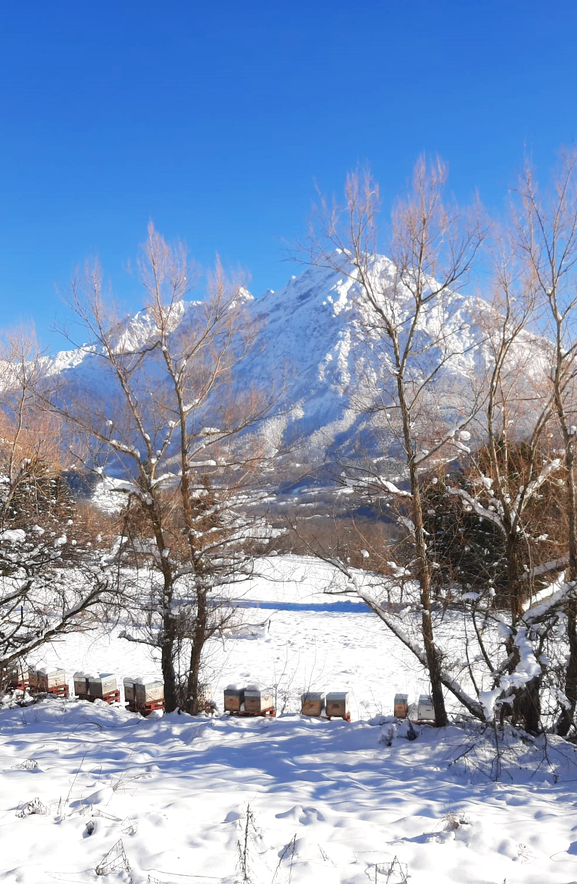
Lieux d’hivernage
En France :
  Montagne :
  1000 m d’altitude dans les Hautes-Alpes ou Alpes maritimes
  Hivernage partiel jusqu’à mi-décembre
  Plaine/Littoral
  250 – 300 m d’altitude dans les Hautes-Alpes ou le Var
En Italie :
  Montagne :
  700 m d’altitude dans les Apennins ou le Piémont
  Plaine
  170 m d’altitude dans la plaine du Pô
5
Notes:
Despite the defenses, Varroa has dramatic impacts on colonies in most cases.
These are attributed to the direct impact of V on individuals, but also, and maybe primarily to the association of the mite with several viruses.
…
Therefore, we can wonder what actually causes the pathogenic effects that are observed in the presnece of V.
…
The leads us to revise the conception of H/P relationship from a bilateral situation, to a 3 way relationship that included virus as a main actor.

Slide 6
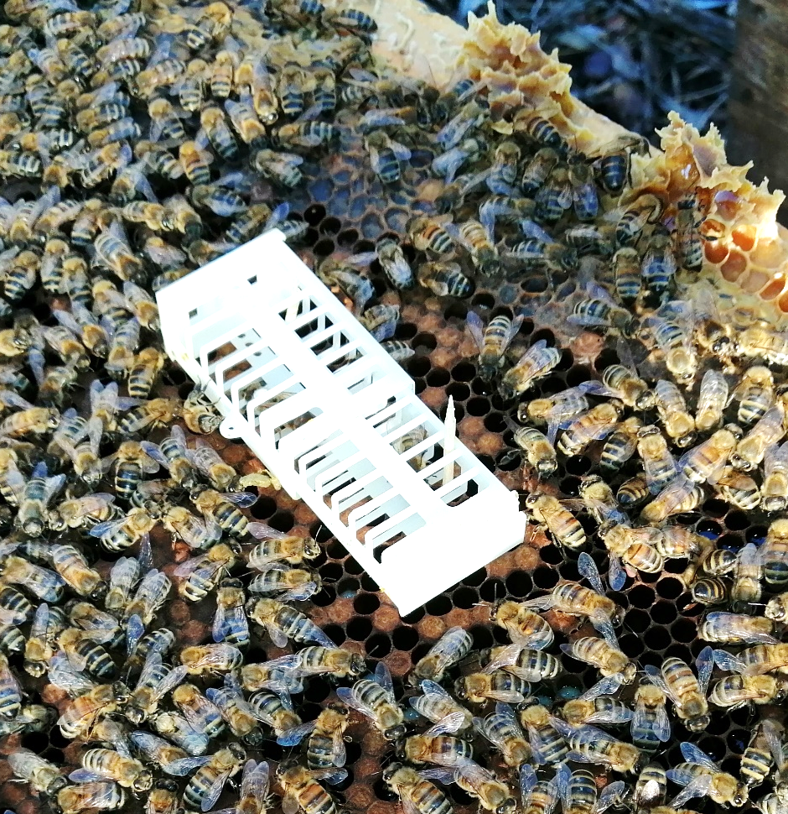
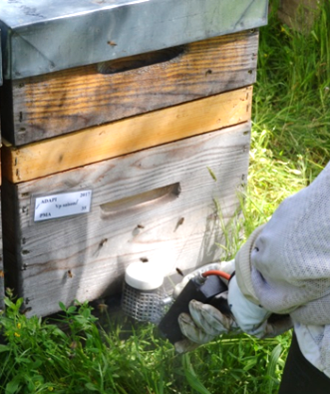
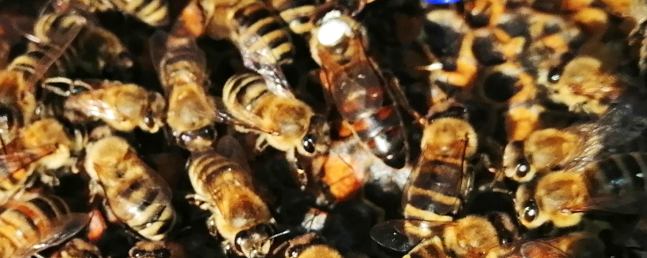
Principe de l’encagement
En fin de miellée d’été ou en hiver
21 à 25 jours
3-4 jours
J-25
Encagement
De reines
(cage Scalvini été et hiver
Cage chinoise hiver)
J0
Libération
des reines
Application
du 1er AO
J3-J4
2ème AO
6
Notes:
Despite the defenses, Varroa has dramatic impacts on colonies in most cases.
These are attributed to the direct impact of V on individuals, but also, and maybe primarily to the association of the mite with several viruses.
…
Therefore, we can wonder what actually causes the pathogenic effects that are observed in the presnece of V.
…
The leads us to revise the conception of H/P relationship from a bilateral situation, to a 3 way relationship that included virus as a main actor.

Slide 7
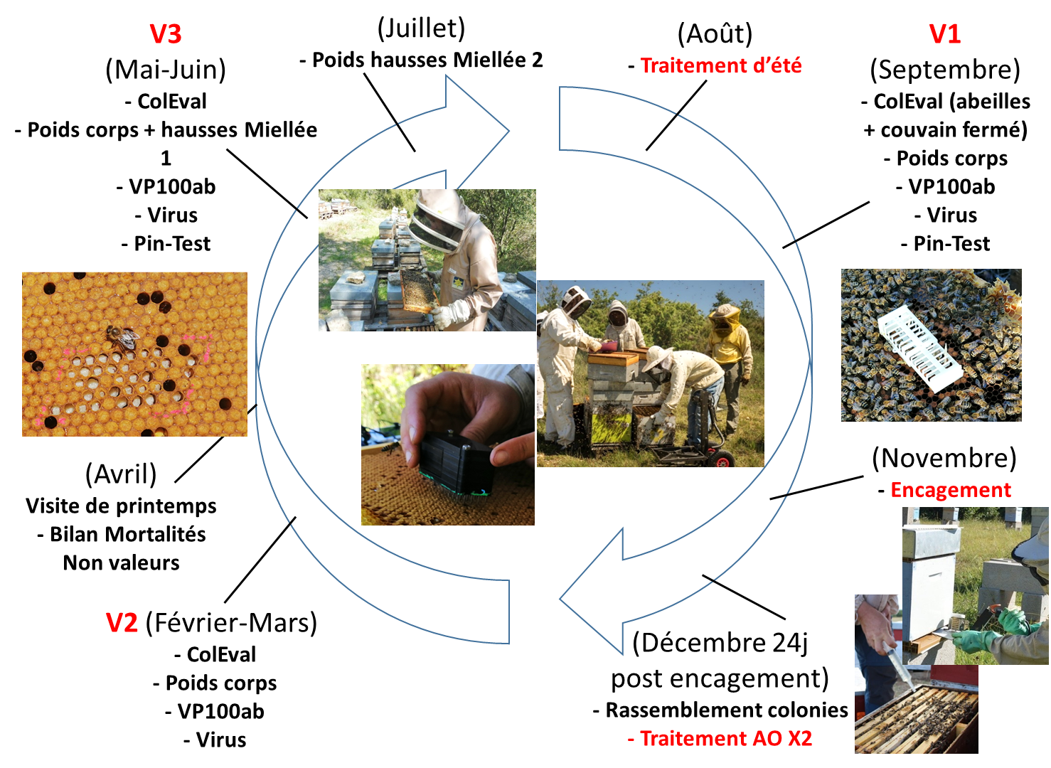
Calendrier annuel des opérations :
Mesures réalisées
7
Notes:
Despite the defenses, Varroa has dramatic impacts on colonies in most cases.
These are attributed to the direct impact of V on individuals, but also, and maybe primarily to the association of the mite with several viruses.
…
Therefore, we can wonder what actually causes the pathogenic effects that are observed in the presnece of V.
…
The leads us to revise the conception of H/P relationship from a bilateral situation, to a 3 way relationship that included virus as a main actor.

Slide 8
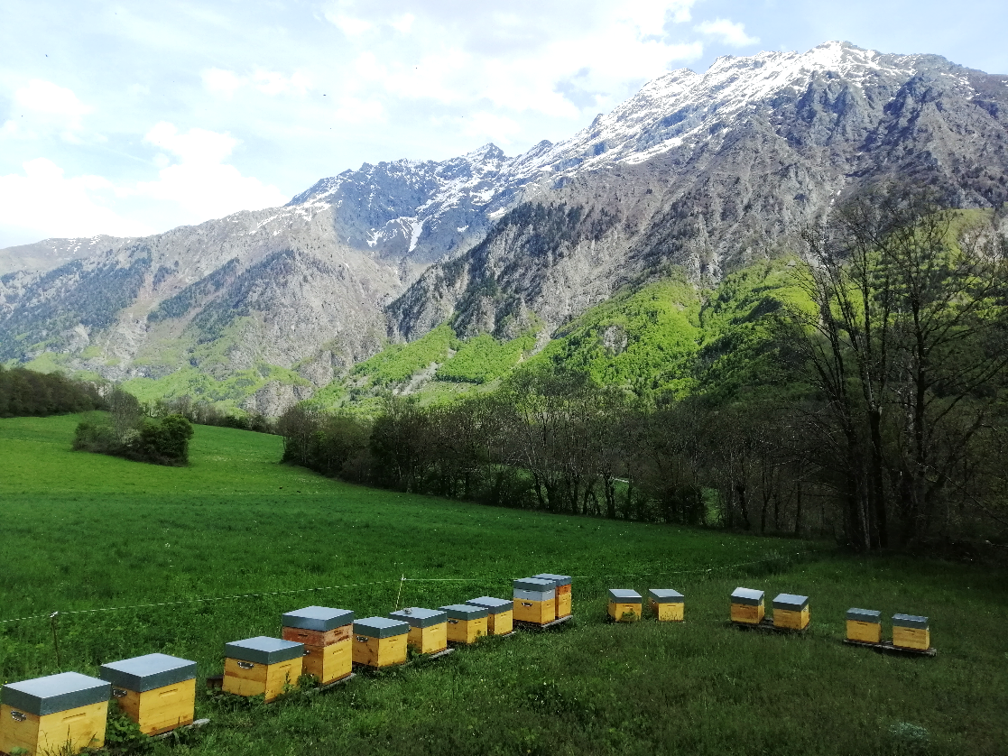
Comparaison des stratégies
de luttes contre Varroa
Taux de Varroas phorétiques
Population des colonies → Abeilles & couvain
Production des colonies
Mortalité hivernale
Charges virales
8
Notes:
Despite the defenses, Varroa has dramatic impacts on colonies in most cases.
These are attributed to the direct impact of V on individuals, but also, and maybe primarily to the association of the mite with several viruses.
…
Therefore, we can wonder what actually causes the pathogenic effects that are observed in the presnece of V.
…
The leads us to revise the conception of H/P relationship from a bilateral situation, to a 3 way relationship that included virus as a main actor.

Slide 9
Merci pour votre attention !
Grazie per l'attenzione !
http://w3.avignon.inra.fr/lavandes/biosp/APIN_ApinvernoFR.html

