Slide 1



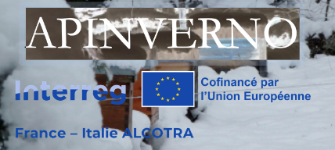

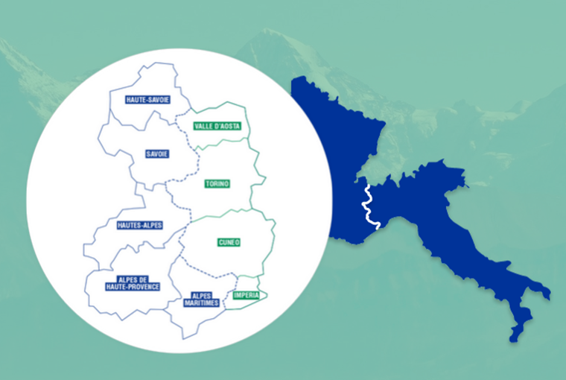
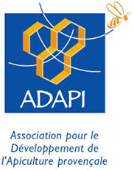


Résistance à varroa : le pin test, outil d’évaluation du comportement hygiénique des colonies
Coline Kouchner - ADAPI
Pelleautier : 11 janvier/gennaio 2024
Restitution finale / Incontro divulgativo finale

Slide 2

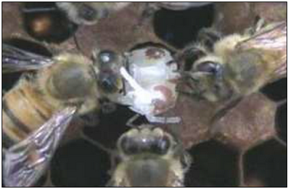
Le comportement hygiénique, qu’est-ce que c’est ?
Capacité de la colonie à se débarrasser du couvain « à problème » : maladies,…
→ Limite la propagation des maladies
Lien avec la résistance à varroa ?
  Corrélation avec différents mécanismes de résistance à varroa
  Par rapport à d’autres méthodes : évaluation indirecte… mais plus facile à mettre en œuvre !
© ADA Grand-Est
Cannibalisme de nymphe non viable
Notes:
Despite the defenses, Varroa has dramatic impacts on colonies in most cases.
These are attributed to the direct impact of V on individuals, but also, and maybe primarily to the association of the mite with several viruses.
…
Therefore, we can wonder what actually causes the pathogenic effects that are observed in the presnece of V.
…
The leads us to revise the conception of H/P relationship from a bilateral situation, to a 3 way relationship that included virus as a main actor.

Slide 3




Comment évaluer le comportement hygiénique : le pin test
Principe de l’évaluation du comportement hygiénique : endommagement d’une zone de couvain identifiée pour évaluer la réponse de la colonie
Pin test : piquage du couvain (aiguille)
Notes:
Despite the defenses, Varroa has dramatic impacts on colonies in most cases.
These are attributed to the direct impact of V on individuals, but also, and maybe primarily to the association of the mite with several viruses.
…
Therefore, we can wonder what actually causes the pathogenic effects that are observed in the presnece of V.
…
The leads us to revise the conception of H/P relationship from a bilateral situation, to a 3 way relationship that included virus as a main actor.

Slide 4
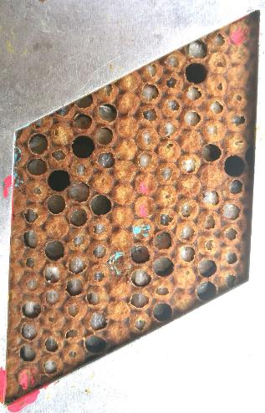
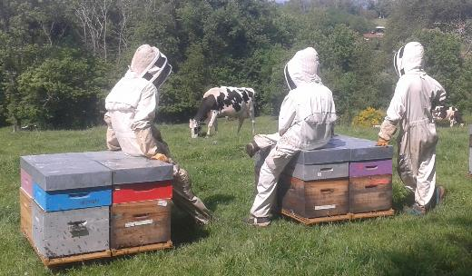
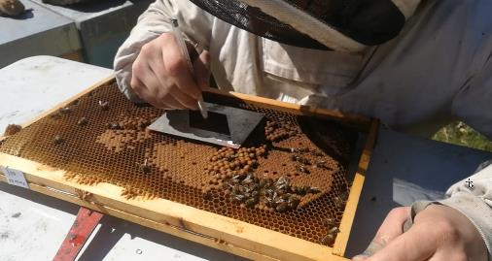
Comment évaluer le comportement hygiénique : le pin test
Piquage d’une zone de couvain au bon stade
Attente d’un nettoyage éventuel
Vérification du nettoyage
Notes:
Despite the defenses, Varroa has dramatic impacts on colonies in most cases.
These are attributed to the direct impact of V on individuals, but also, and maybe primarily to the association of the mite with several viruses.
…
Therefore, we can wonder what actually causes the pathogenic effects that are observed in the presnece of V.
…
The leads us to revise the conception of H/P relationship from a bilateral situation, to a 3 way relationship that included virus as a main actor.

Slide 5
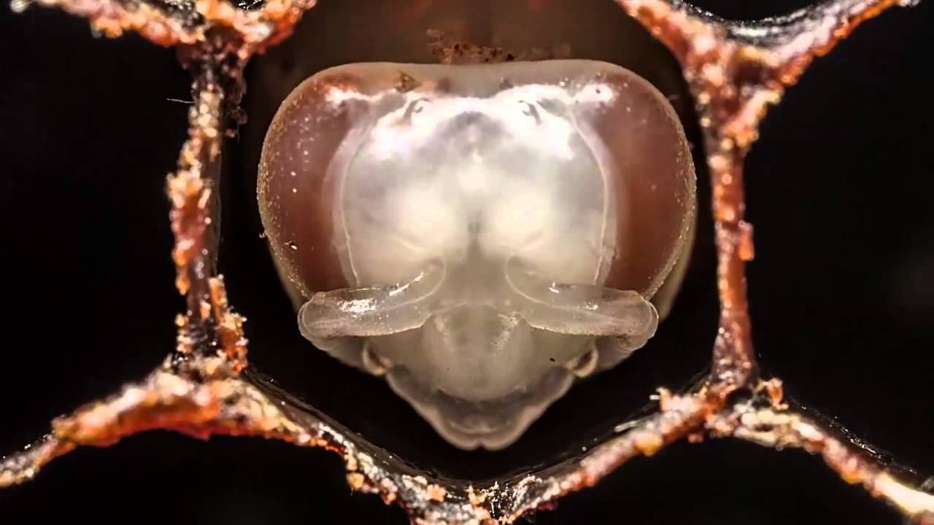
Comment évaluer le comportement hygiénique : le pin test
Piquage d’une zone de couvain au bon stade
Attente d’un nettoyage éventuel
Vérification du nettoyage
©Association Reine
de Pique
Notes:
Despite the defenses, Varroa has dramatic impacts on colonies in most cases.
These are attributed to the direct impact of V on individuals, but also, and maybe primarily to the association of the mite with several viruses.
…
Therefore, we can wonder what actually causes the pathogenic effects that are observed in the presnece of V.
…
The leads us to revise the conception of H/P relationship from a bilateral situation, to a 3 way relationship that included virus as a main actor.

Slide 6
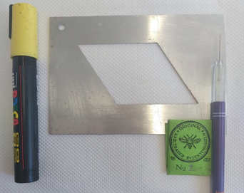
Comment évaluer le comportement hygiénique : le pin test
Piquage d’une zone de couvain au bon stade
Attente d’un nettoyage éventuel
Vérification du nettoyage
50 cellules
Attention à bien sauter les cellules déjà vides !
Repérer la zone (marqueur)
©Association Reine
de Pique
Notes:
Despite the defenses, Varroa has dramatic impacts on colonies in most cases.
These are attributed to the direct impact of V on individuals, but also, and maybe primarily to the association of the mite with several viruses.
…
Therefore, we can wonder what actually causes the pathogenic effects that are observed in the presnece of V.
…
The leads us to revise the conception of H/P relationship from a bilateral situation, to a 3 way relationship that included virus as a main actor.

Slide 7
Comment évaluer le comportement hygiénique : le pin test
Piquage d’une zone de couvain au bon stade
Attente d’un nettoyage éventuel
Vérification du nettoyage
Quel temps d’attente ?
24h ? 6h…?
Objectif de classer les colonies : on doit voir des différences !
Adapter le temps à ses colonies : essayer un temps (ex. 5h) qui peut ensuite être allongé ou raccourci selon les résultats
Le même temps pour toutes les colonies !
Notes:
Despite the defenses, Varroa has dramatic impacts on colonies in most cases.
These are attributed to the direct impact of V on individuals, but also, and maybe primarily to the association of the mite with several viruses.
…
Therefore, we can wonder what actually causes the pathogenic effects that are observed in the presnece of V.
…
The leads us to revise the conception of H/P relationship from a bilateral situation, to a 3 way relationship that included virus as a main actor.

Slide 8
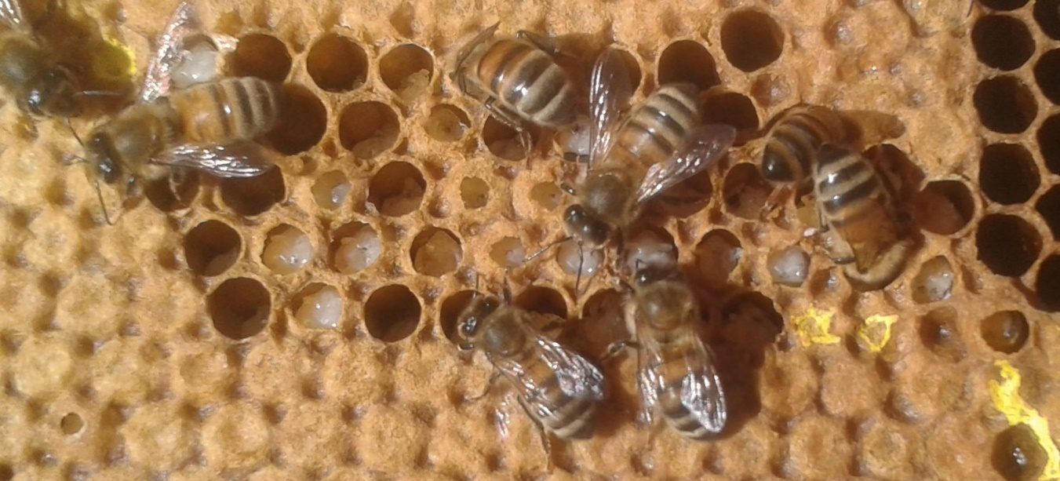
Comment évaluer le comportement hygiénique : le pin test
Piquage d’une zone de couvain au bon stade
Attente d’un nettoyage éventuel
Vérification du nettoyage
Notes:
Despite the defenses, Varroa has dramatic impacts on colonies in most cases.
These are attributed to the direct impact of V on individuals, but also, and maybe primarily to the association of the mite with several viruses.
…
Therefore, we can wonder what actually causes the pathogenic effects that are observed in the presnece of V.
…
The leads us to revise the conception of H/P relationship from a bilateral situation, to a 3 way relationship that included virus as a main actor.

Slide 9
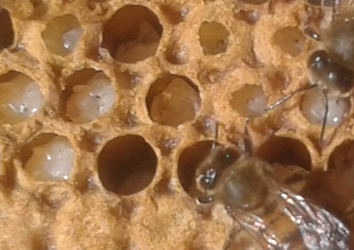
Comment évaluer le comportement hygiénique : le pin test
Piquage d’une zone de couvain au bon stade
Attente d’un nettoyage éventuel
Vérification du nettoyage
Notes:
Despite the defenses, Varroa has dramatic impacts on colonies in most cases.
These are attributed to the direct impact of V on individuals, but also, and maybe primarily to the association of the mite with several viruses.
…
Therefore, we can wonder what actually causes the pathogenic effects that are observed in the presnece of V.
…
The leads us to revise the conception of H/P relationship from a bilateral situation, to a 3 way relationship that included virus as a main actor.

Slide 10
Comment évaluer le comportement hygiénique : le pin test
Piquage d’une zone de couvain au bon stade
Attente d’un nettoyage éventuel
Vérification du nettoyage
Calcul du score hygiénique :
Nombre de cellules nettoyées ou en cours de nettoyage
Nombre de cellules piquées
100 *
⚠ Pas de score « bon » dans l’absolu : méthode de comparaison entre colonies
Notes:
Despite the defenses, Varroa has dramatic impacts on colonies in most cases.
These are attributed to the direct impact of V on individuals, but also, and maybe primarily to the association of the mite with several viruses.
…
Therefore, we can wonder what actually causes the pathogenic effects that are observed in the presnece of V.
…
The leads us to revise the conception of H/P relationship from a bilateral situation, to a 3 way relationship that included virus as a main actor.

Slide 11
Comment évaluer le comportement hygiénique : le pin test
⚠ Points d’attention
Adaptation et respect du temps
Comparaison entre colonies sur un même rucher, un même jour
Répéter l’opération !
Méthode de sélection : à intégrer avec ses autres objectifs de sélection !
Perspectives
Aller de la gestion du varroa dans les colonies vers une intégration du varroa dans la sélection
Projet Meliorapi
Notes:
Despite the defenses, Varroa has dramatic impacts on colonies in most cases.
These are attributed to the direct impact of V on individuals, but also, and maybe primarily to the association of the mite with several viruses.
…
Therefore, we can wonder what actually causes the pathogenic effects that are observed in the presnece of V.
…
The leads us to revise the conception of H/P relationship from a bilateral situation, to a 3 way relationship that included virus as a main actor.

Slide 12
Merci pour votre attention !
Grazie per l'attenzione !
http://w3.avignon.inra.fr/lavandes/biosp/APIN_ApinvernoFR.html

